Slide 1

Heading Home Hennepin Executive Committee April 2021
Introductions
Approval of minutes
COVID – 19 and the homeless/health response
Responding to the economic impacts of COVID – 19
State of homelessness in 2021
Lessons from COVID
Continuum of Care notifications

Slide 2
COVID – 19 and the homeless/health response
April 2021
Blair Harrison, Minnesota Department of Health
Martha Trevey, Hennepin County Healthcare for the Homeless
Danielle Werder, Hennepin County Office to End Homelessness

Slide 3
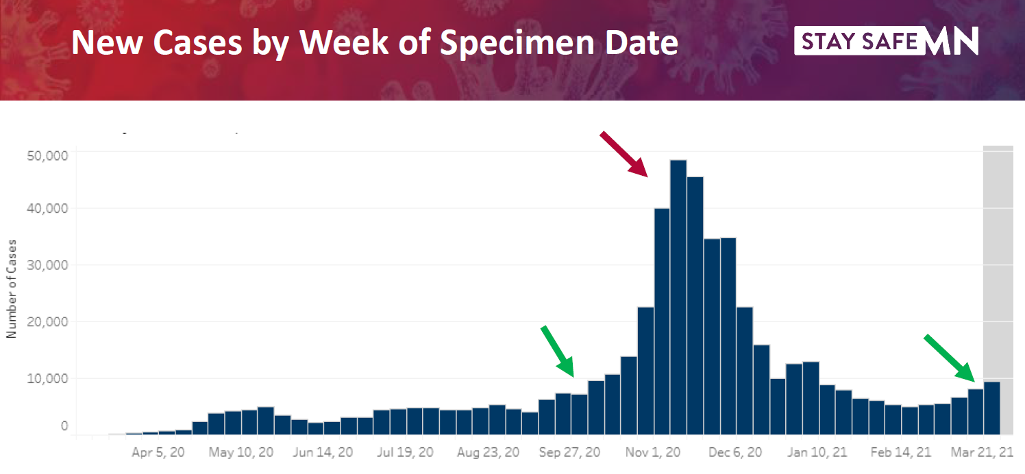
Week of Specimen Collection Date

Slide 4
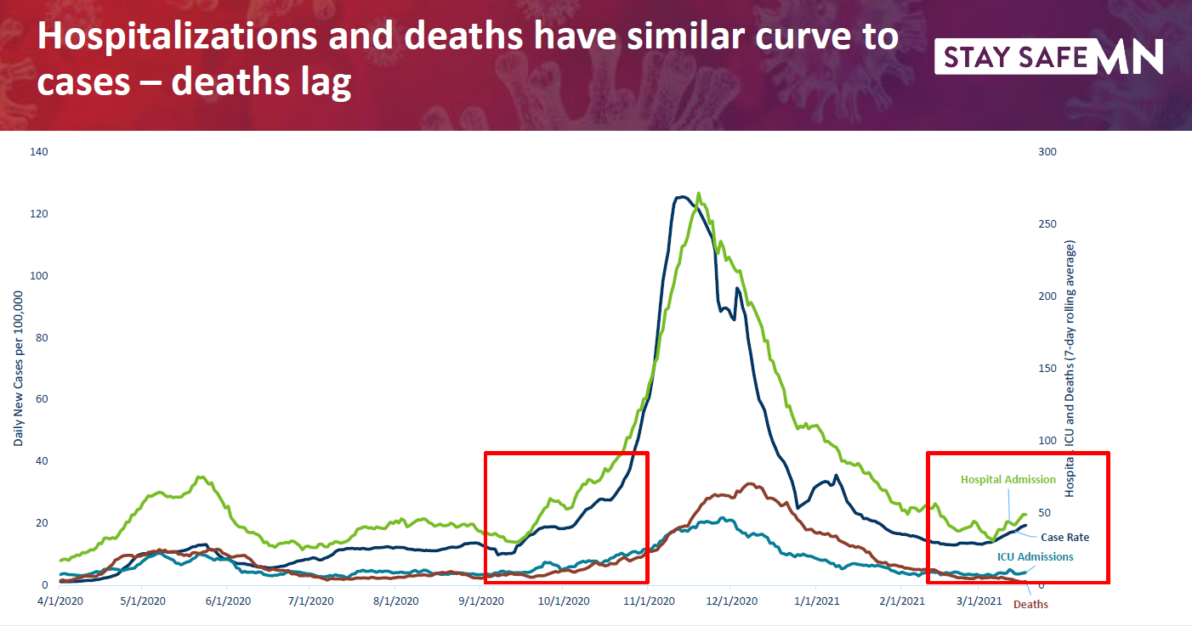
Notes:
Source: MDH COVID-19 Case data, current as of 3/20/2021; based on date of specimen (case), admission (hospital, ICU), death (deaths)

Slide 5
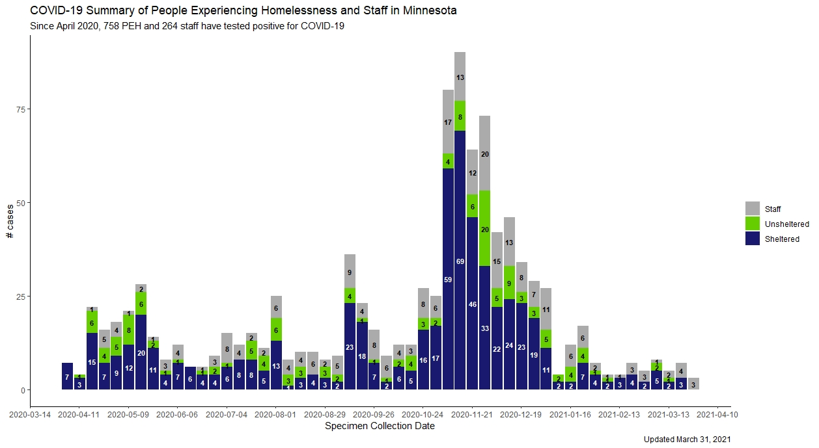

Slide 6
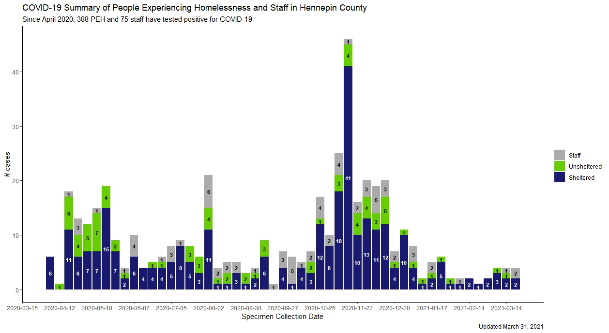

Slide 7
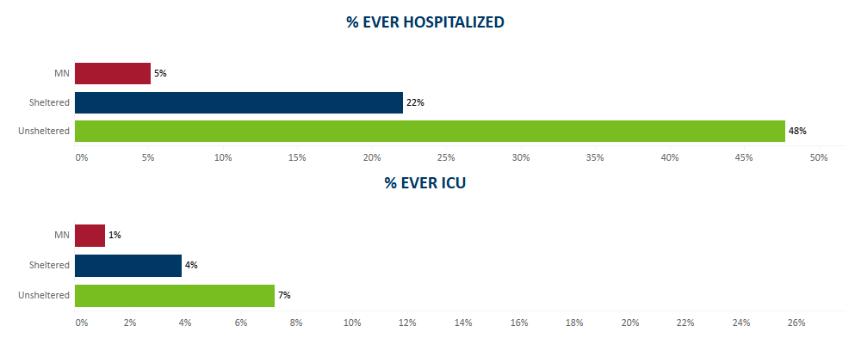
Hospitalization & ICU Data for COVID+ People Who Live in Minnesota

Slide 8
Vaccine Efforts Among PEH
Statewide summary
Challenges
Highlights

Slide 9
COVID Isolation & Quarantine
Continue with Triage Line & Isolation Shelter Hotel
Overall, slower in 2021 than in 2020
All I & Q staff are now under HCH (previously had support from HC ‘pandemic response’)
2020 COVID Numbers
COVID Tests at HCH clinics (not testing events) | 240
Patients with COVID | 123
Encounters at the Iso Hotel (RN or Medical Provider) | 770
Distinct patients who stayed at the Iso Hotel | 490

Slide 10
COVID Vaccination: A focus on equity
From the beginning, HCH’s vaccine campaign aimed to be anti-racist, relationship-based, and trauma-informed.
How are we doing this?
Educating ourselves and appreciating valid reasons why BIPOC may be hesitant to receive the vaccine.
Engaging in one-on-one conversations about vaccination at every patient encounter.
Low barrier model, no appointment necessary.
If not ready for the vaccine, offer opportunities for the future.
Respect autonomy, not mandatory for shelter reservation.

Slide 11
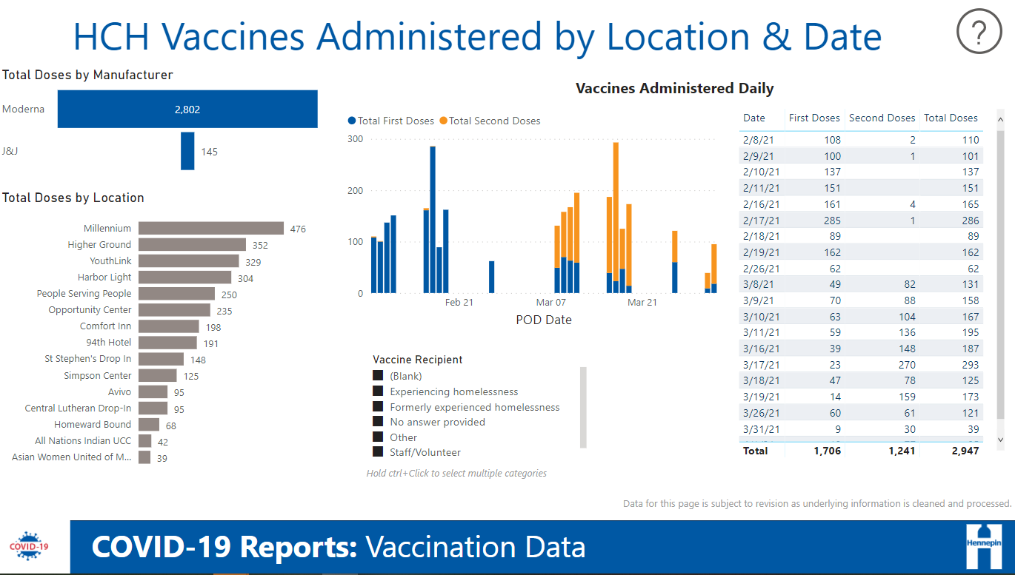
COVID Vaccination
3rd round vaccine PODs (Point of Distribution) started this week
Started with Moderna and transitioning to Janssen (J&J)
Tracking data through an interactive dashboard

Slide 12
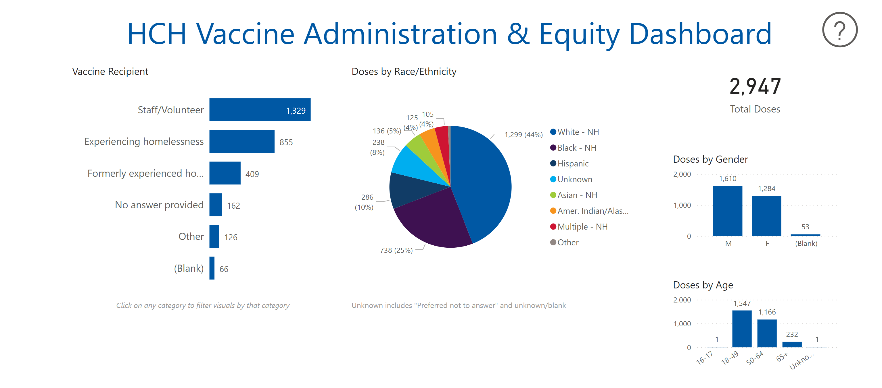
Measuring Equity
Dashboard drills down by site, homelessness status, and vaccine completion using a racial equity lens.
Data informs our interventions

Slide 13
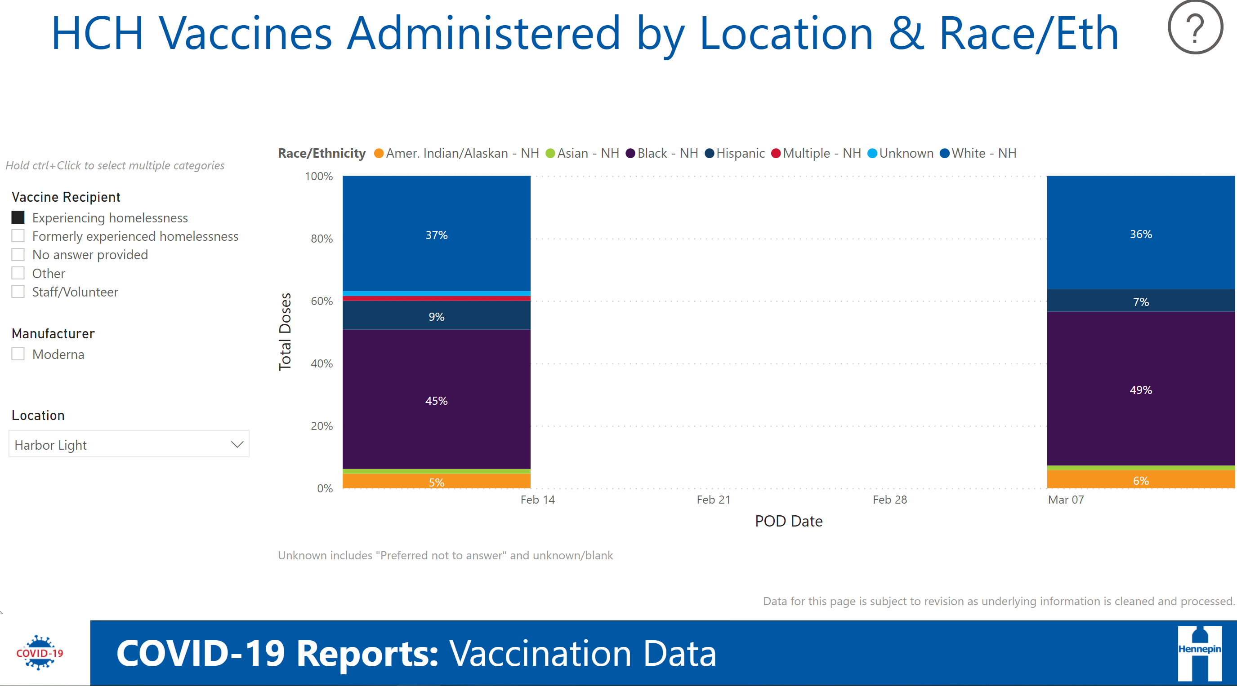
Measuring Vaccine Uptake by Race & Ethnicity

Slide 14
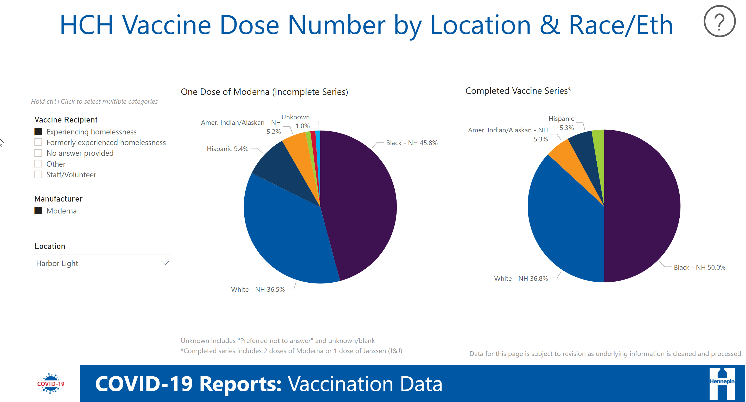
Measuring Completion by Race & Ethnicity
Measuring Completion by Race & Ethnicity

Slide 15

Looking to the Future
Continue to monitor racial disparity data and tailor interventions to meet needs
Janssen vaccine in clinics
Pop-up & mobile vaccine clinics focused on the unsheltered community
Partnership with MDH Mobile Vaccine Units 4/28 & 4/29

Slide 16
Update on Hotels to Housing Project
Launched in June of 2020 –
Project objective is to engage with individuals staying in HC high-risk hotel sites to move into permanent housing before high-risk sites close
191 people housed since launch:
Current rate of 3.4 people housed per week.

Slide 17
Hotel to Housing stats to date:
Increased initial case management team by 12 in October – once new team started, H2H’s housing outcomes doubled!
81 people have been referred to Long Term Support Services and have been assessed for an Elderly or CADI waiver!
Helping people obtain vital documents:
ID events – partnering with HC service centers
At least 125 people applied for Birth Certificates since 9/2020
Recently expanded Hotels to Housing project to include all individuals staying in HC funded high-risk sites (doubled project scope).

Slide 18
Responding to the economic impacts of COVID – 19
April 2021
Mikkel Beckmen, Hennepin County Housing Stability

Slide 19
Federal Emergency Rental Assistance- 2021
Hennepin - $25M Mpls - $12
MN Housing, and other metro jurisdictions also received allocations. ($380M total)
Funds pay prospective rent in addition to arrears
Hennepin launched a two-week ‘sprint’ program on March 5.
In those two weeks, we received 3,797 applications. We are averaging $4100/household, and as of today have processed over 1,000 applications.
Statewide application will open in mid-April.

Slide 20
Federal Emergency Rental Assistance- 2021
Hennepin and Minneapolis co-released an RFP to provide outreach and navigation. Hennepin and Minneapolis are using our COVID-19 CDBG funds to engage these providers ($300K from Hennepin) who will reach out to their cultural and geographic communities to build trust in the programs, help people to apply for rent assistance.
As additional emergency rent assistance from the American Rescue Plan arrives, we will program it into these existing structures.

Slide 21
State of the Homeless System
April 2021
Mark Legler, Hennepin County Housing Stability

Slide 22




Hennepin County Nightly Homelessness 2020-21
Decrease of 119 (9%)
Decrease of 257 (55%)
Increase of 147 (17%)
Decrease of 9 (14%)
=
+
+
1,277 people in shelters
213 people in families in shelters
1,010 single adults in shelters
54 youth in youth-specific shelters
Key
642 unsheltered
2020 Count
= 54 people

Slide 23
2013-20 average

Slide 24
Families significantly more likely to include people of color vs. overall population experiencing homelessness (89%)

Slide 26
957 beds re-reserved (753-1,024)
41 beds available at beginning of day (0-174)
47 reservations made during the day at Adult Shelter Connect (0-150)
0 people unable to reserve bed during day (0-104)
4 reservations made by people new to shelter in Hennepin (0-15)
25 reservations made after hours (5-59)
0 people unable to reserve bed after hours (0-29)
Daily shelter flow
Single adults
998 single adults sheltered per night (806-1,096)
All numbers 2020 daily medians (range in parentheses).

Slide 27
2
AICDC
0
2
Vouchered
3
2
Higher Ground
2
Example of inflow and outflow from single adult shelters for day in March 2020 39 people left shelter and 32 people entered shelter
2
Simpson
2
19
Safe Bay
25
Inflow
Outflow
Shelter
5
Sally’s
7

Slide 28
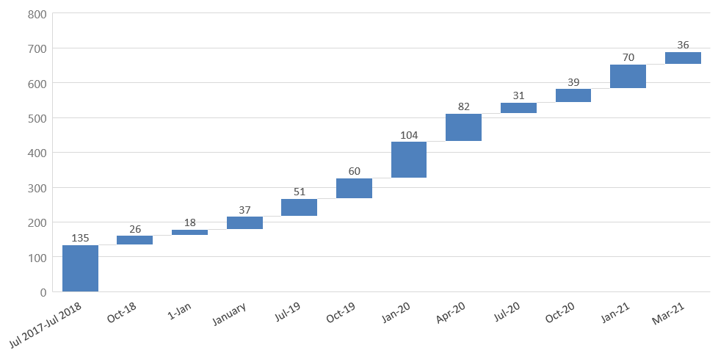
677 chronically homeless people housed since July 2017 Average length of time homeless= three years

Slide 29
Lessons from COVID
April 2021
David Hewitt, Hennepin County Housing Stability / Office to End Homelessness

Slide 30
Tactics to grow our impact
Minimize people entering homelessness
Maximize people exiting homelessness
Emergency renter assistance
Legal support for renters
Diversion case management, financial assistance
Renter Navigation
Family self-pay and eligibility criteria
24/7 shelter
Shelter case management
Low barrier shelters
Project-based subsidies
Supportive Housing Strategy
Single Room Occupancy housing

Slide 31




Emergency renter assistance
Entering homelessness
Cost: $9.8 million annually Impact: 6,000 households (12,000 people) each year
What | Expand emergency financial support with local resources to help vulnerable households pay for rent and utilities
Why | Prevents households in crisis from experiencing housing instability and entering shelter
How | Flexible funds, navigators, legal representation at housing court
Impact on disparities
Two-thirds households served earn <30% AMI, half from areas disproportionately impacted by COVID, communities of color
What: Expand emergency financial support with local resources to help vulnerable households pay for rent and utilities
How: Flexible funds, navigators, legal assistance at housing court
Why: Prevents households in crisis from experiencing housing instability and entering shelter
Cost/impact: $9.8 million annually, 6,000 households (18,000 people) each year
Impact on disparities: Two-thirds households served earn <30% AMI, half from areas disproportionately impacted by COVID, communities of color

Slide 32
Shelter diversion
Entering homelessness
Cost: $1 million annually Impact: 750 people each year
What | Case management and financial assistance for families and individuals
Why | Reduces people experiencing/beginning homelessness
How | Co-creation of housing stabilization plan with financial assistance available to help with basic needs
Impact on disparities
Leverages strengths and networks of people, especially people of color, to avoid the shelter system
What: Case management and financial assistance for families and individuals
Why: Reduces people experiencing/beginning homelessness
Cost/Impact: $1 Million annually, 750 people
Impact on disparities: Leverages strengths and networks of people, especially POC, to avoid the shelter system

Slide 33
Lowering barriers
Exiting homelessness
Cost: $500,000 annually Impact: 700 families (2,100 people) each year
What | Family self-pay and family eligibility criteria
Why | Empowers more families to maintain stability and avoid unsheltered and unsafe settings
How | Engage family voices to design new financial empowerment approach Use racial equity lens to redefine family eligibility criteria
Impact on disparities
Most impacted are families of color who face structural racism and generational financial trauma
What: Family self-pay and eligibility criteria
Why: Empowers more families to maintain stability and avoid unsheltered and unsafe settings
How:
Engage family voices to design new financial empowerment approach
Use racial equity lens to redefine family eligibility criteria
Cost/Impact: $500,000 annually, 700 families (2,100 people)
Disparities impact: Most impacted are families of color who face structural racism and generational financial trauma

Slide 34
Improving outcomes – 24/7
Exiting homelessness
Cost: $3 million annually Impact: 3,720 people each year
What | 24/7 shelter operations
Why | Reduces people on streets, increases shelter capacity, better facilitates housing outcomes
How | Sustain COVID-19 level shelter investment
Impact on disparities
Existing shelters serve majority African American population experiencing homelessness
What: 24/7 shelter operations
Why: reduces people on streets, increases shelter capacity
How: Sustain COVID-19 level shelter investment
Cost/impact: $3 million annually, 3,720 people
Disparities impact: Existing shelters serve majority African American population experiencing homelessness

Slide 35
Improving outcomes – case management
Exiting homelessness
Cost: $3 million annually Impact: 1,000 people each year
What | Expanded case management at emergency shelters
Why | Connects more vulnerable people to housing programs faster
How | Add 24 FTEs to provide case management
Impact on disparities
People of color experience homelessness at higher rates and face greater barriers to housing
What: Expanded case management at emergency shelters
Why: Connects more vulnerable people to housing programs faster
How: Add 24 FTEs
Cost/impact: $3 million, 1,000 people
Disparities impact: People of color experience homelessness at higher rates and face greater barriers to housing

Slide 36
Improving outcomes – employment services
Exiting homelessness
Cost: $750,000 annually Impact: 200 people each year
What | Access to employment services and training for shelter diversion
Why | Receiving employment services and earning income positively impacts housing stability
How | Employment coaching, skills development through training and education
Impact on disparities
Majority of participants are people of color. Addressing employment readiness will ensure receiving and maintaining employment, increasing earning potential and stabilizing housing.
What: Coordinated support and access to financial assistance, health care, food, employment assistance for shelter diversion
Why: Social determinants of health impact housing stability. This population needs hands-on assistance to apply and navigate available support.
How: 5-6 FTEs to work with applicants at shelters
Cost/Impact: $750,000 annually, 200 people
Disparities impact: Majority of shelter and diversion participants are people of color. Balances digital and in-person support needed for access.

Slide 37
Improving outcomes – low barrier shelters
Exiting homelessness
Cost: $3.6 million annually Impact: 900 people
What | Continue gap funding for new shelter programs
Why | Housing focused, target people not engaging with existing shelters
How | New shelter models specifically designed to respond to needs of people who go unsheltered
Impact on disparities
Culturally-specific low-barrier programs
What: Continue gap funding for new shelter programs
Why: Housing focused, target people not engaging with existing shelters
Cost/impact: $3.6 million, 900 people per year
Disparities impact: Culturally specific low-barrier programs

Slide 38

Project-based subsidies
Exiting homelessness
Cost: $31.68 million over 10 years Impact: 1,000 units
What | Project-based subsidies to further lower rent rates in county-funded capital projects
Why | Create more units at or below 30% AMI in county financed projects
How | Project-based vouchers
Impact on disparities
Households of color disproportionately represented at 30% AMI level
What: Project-based subsidies to further lower rent rates in county-funded capital projects
How: Project-based vouchers
Why: Create more units at/below 30% AMI in county financed projects
Households of color disproportionately represented at 30% AMI level
Cost/Impact: $540,000, 100 households per year

Slide 39
Supportive housing strategy
Exiting homelessness
Cost: $91.5 million (over 10 years) Impact: 1,000 more units by 2030
What | Developing 1,000 new units of long-term supportive housing by 2030
Why | Supportive housing positively impacts life outcomes, decreases strain on public systems, improves livability and stability of neighborhoods
How | Increase the County’s role in developing supportive housing by purchasing more intentionally and proactively $50 million in HRA funding, $41.5 million in county funding invested over next ten years to leverage $282 million in outside investment
Impact on disparities
All units affordable at less than 30% AMI, majority of county identified priority population are people of color
What: Developing 1,000 new units of long-term supportive housing by 2030
How: Increase the County’s role in developing supportive housing by purchasing more intentionally and proactively
Why: Supportive housing positively impacts life outcomes, decreases strain on public systems, improves livability and stability of neighborhoods
Cost/impact: $91.5 million (over 10 years), 1000 units
$50 million in HRA funding, $41.5 million in county funding invested over next ten years to leverage $282 million in outside investment
Disparities impact: All units affordable at less than 30% AMI, majority of county identified priority population are people of color

Slide 40
Single room occupancy
Exiting homelessness
Exiting homelessness
Cost: $97.5 million over 10 years Impact: 1,500 units
What | Finance creation of single room occupancy housing
Why | Fills critical gap in housing market for lowest income populations, reduces shelter reliance
How | Strategic property acquisition, levy or bonding authority financing, single room occupancy taskforce toolkit
Impact on disparities
Households of color disproportionately represented at 30% AMI level
What: Finance creation of SRO housing
How: Strategic property acquisition, levy or bonding authority financing, SRO taskforce toolkit
Why: Fills critical gap in housing market for lowest income populations, reduces shelter reliance
Cost/impact: $97.5 million ($30,000-$100,000 per unit capital) over next 5 years, 1,500 units
Disparities impact: Households of color disproportionately represented at 30% AMI level

Slide 41
Single room occupancy case study – Stevens Square Residence
County acquired VOA property for ~$800,000
Leased to Alliance Housing for $1
Alliance collects nominal rent (i.e. $375/month) to cover operating costs
Residents have own room, shared bathrooms, and kitchen, common spaces
LuMINN, Metro Inn, University Inn will be transitioned to SRO housing post-pandemic

Slide 42
5- and 10-year estimates
Action | 5-year cost/impact | 10-year cost/impact
Emergency renter assistance | $49 million/60,000 people | $98 million/120,000 people
Shelter diversion | $5 million/3,750 people | $10 million/7,500 people
Financial empowerment | $2.5 million/10,500 people | $5 million/21,000 people
24/7 shelter | $15 million/18,500 people | $30 million/37,000 people
Case management | $15 million/(5,000 people)* | $30 million/(10,000 people)*
Employment services | $3.75 million/(5,000 people)* | $7.5 million/(10,000 people)*
Low barrier shelters | $18 million/4,500 people | $36 million/9,000 people
Project based subsidies | $8.64 million/500 units | $31.68 million/1,000 units
Supportive housing | $45.6 million/500 units | $91.3 million/1,000 units
Single Room Occupancy | $32.5 million/500 units | $97.5 million/1,500 units
Digital platforms | $500,000 | $1 million
Total | $195.49 million /97,250 people/1,500 units | $437.98 million/194,500 people/3,500 units
*Included in 24/7 shelter impact number

Slide 43
CoC notifications
April 2021
David Hewitt, Hennepin County Housing Stability / Office to End Homelessness

