Slide 2

Health of CES: July 2018 – March 2020
How to set your image in the placeholder
Right click image and select “format picture”
Select “Picture” tab
Select Crop from the drop down menu
Under Picture Position, use the Offset X and Offset Y to position your image within the frame
delete this when no longer needed
Last update 7/2/2020

Slide 3
Report – General Notes
Reports are through March 2020 (when the CES data standards and reports changed).
The following data/reports are for the time period when the VI-SPDAT was being used.
The data/reports reflect the data included in HMIS – recognizing that CES data quality has improved since the compilation of these reports.
The following data sets have the filters frozen due to data privacy. Any set of responses under 5 cannot be shared due to data privacy concerns. We have tried to identify occurrences when a small number may make the data look out of scale.
There are many options for filtering, but we chose to focus primarily on household type and race in these slides.
Notes on each page are relevant to the most recent reporting period (April 2019 – March 2020)

Slide 4
Definition– Vacancy to Referral
The following notes refer to slides 5-7.
Vacancy to referral includes the time between the date of the "vacancy request" submitted by the housing provider to CES and the date the referral was made to the housing provider by the HC CES priority list manager.
  Time periods reviewed are:
  July 2018 – June 2019
  October 2018 – September 2019
  January 2019 – December 2019
  April 2019 – March 23, 2020

Slide 5
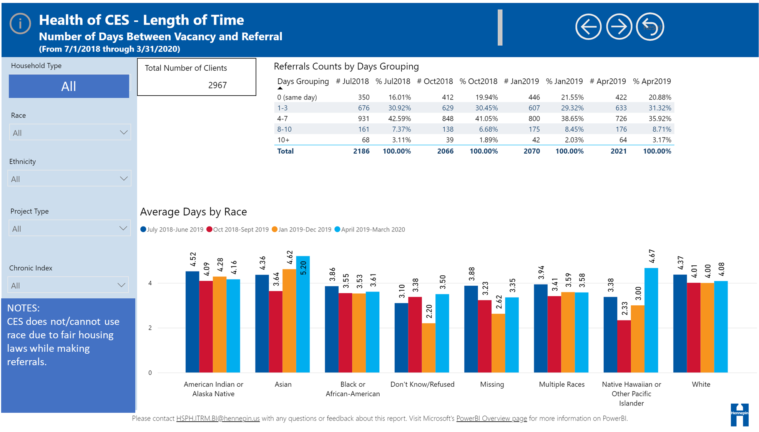

Slide 6
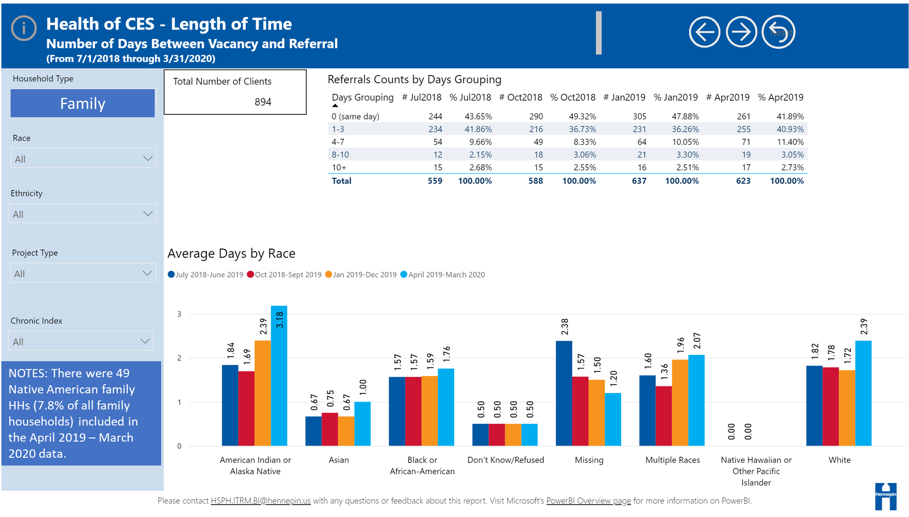

Slide 7
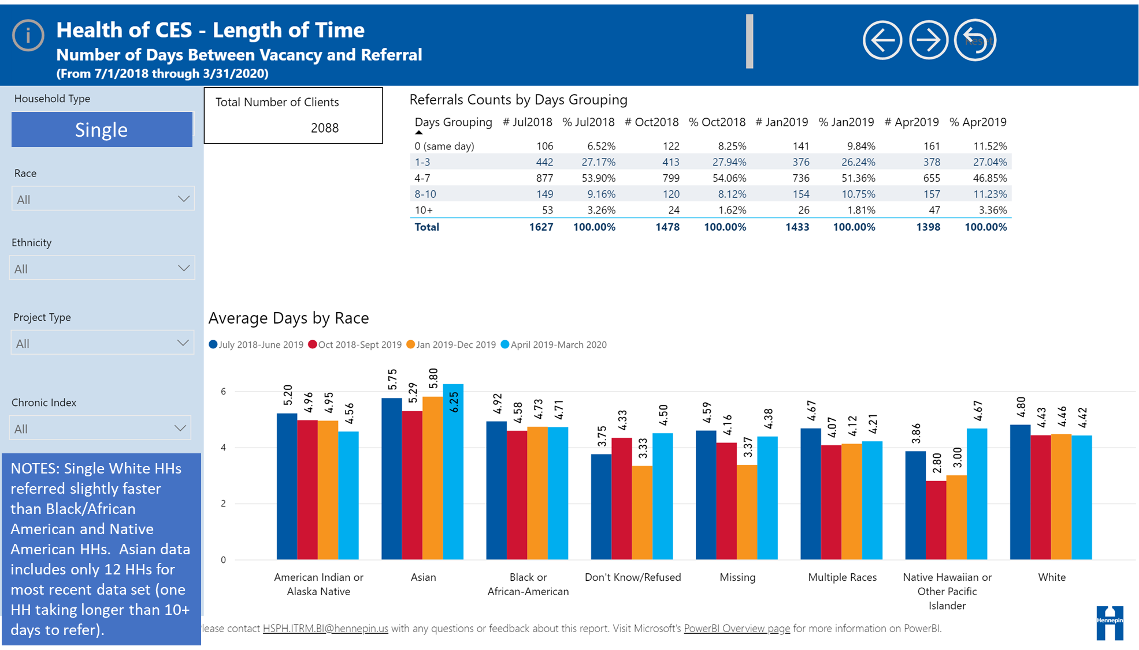

Slide 8
Definition -Start Date to Referral
The following notes refer to slides 9-14.
Start date to referral is the number of days between the date the household was added to the CES priority list and the date the household was referred to a housing provider through CE.
Time periods reviewed are:
  July 2018 – June 2019
  October 2018 – September 2019
  January 2019 – December 2019
  April 2019 – March 23, 2020
HH percentages of the population during the April to March period:
  Native American HHs = 192 (9%)
  Asian HHs = 19 (.8%)
  Black/African American HHs= 1,246 (58%)
  Multiple Race HHs = 199 (9%)
  Native Hawaiian or Other Pacific Islander HHs = 10 (.5%)
  White =488 (23%)

Slide 9
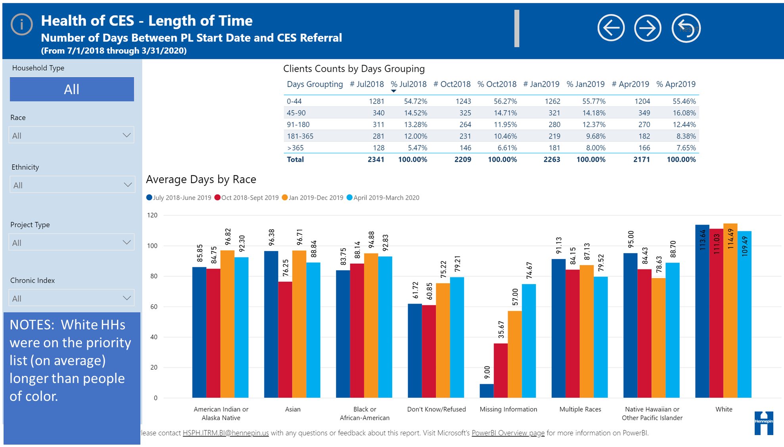

Slide 10
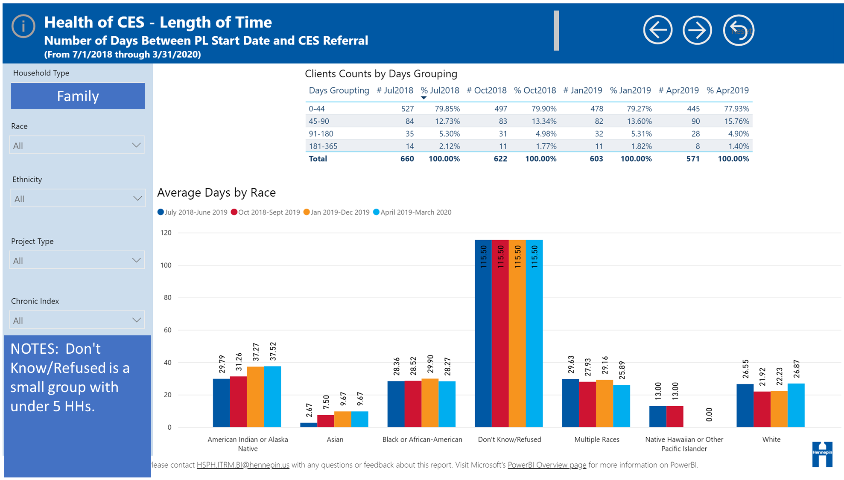

Slide 11
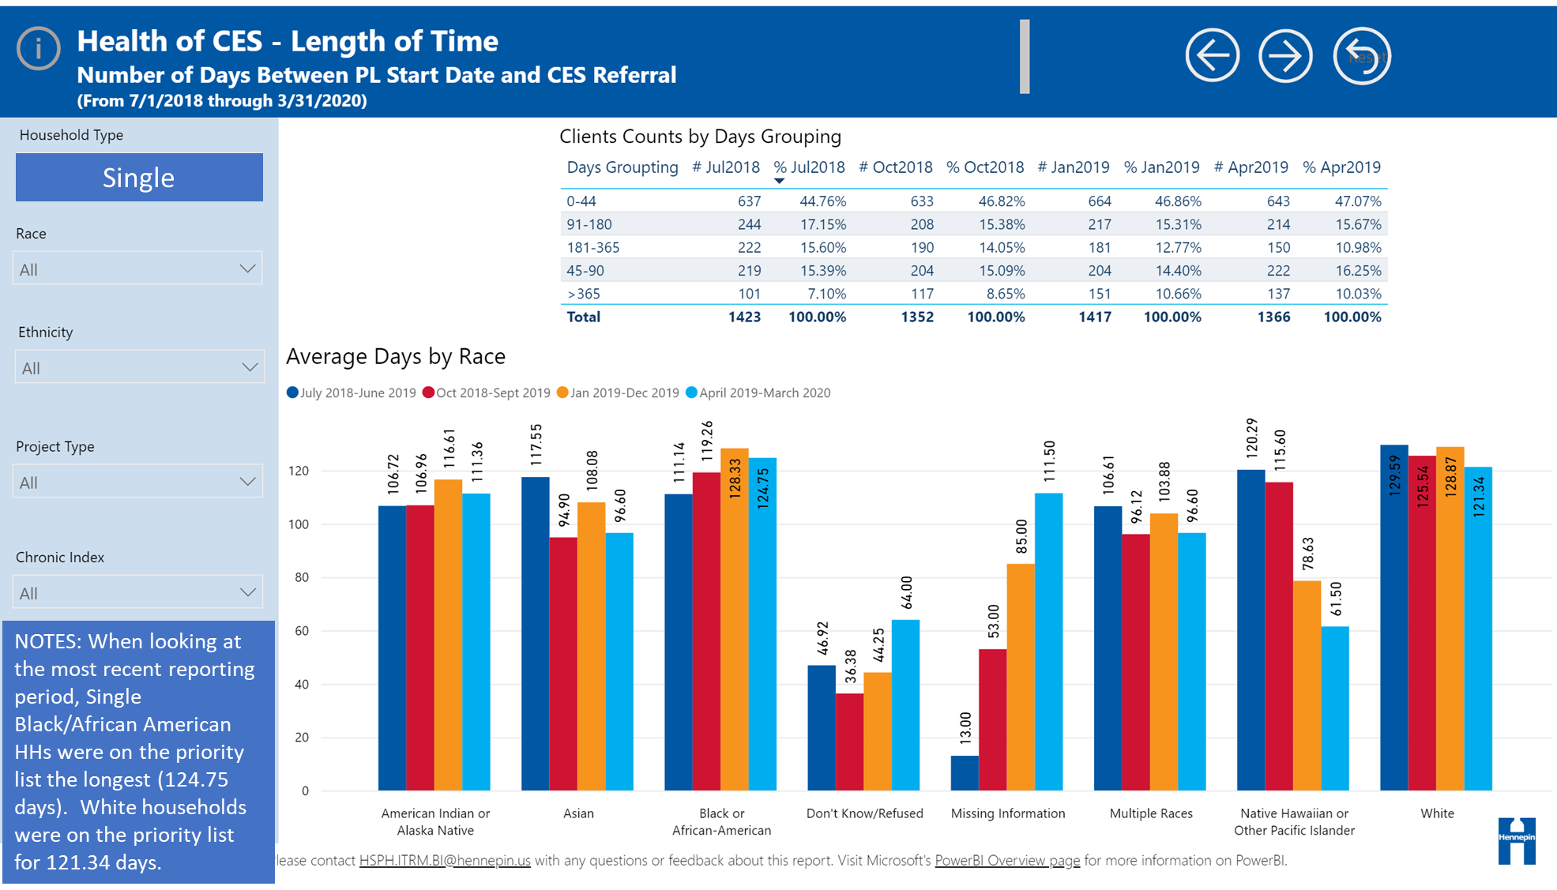

Slide 12
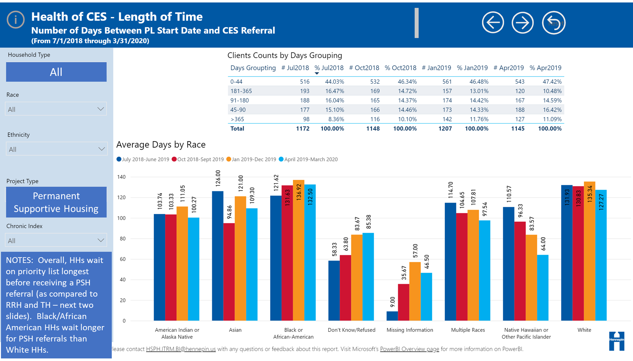

Slide 13
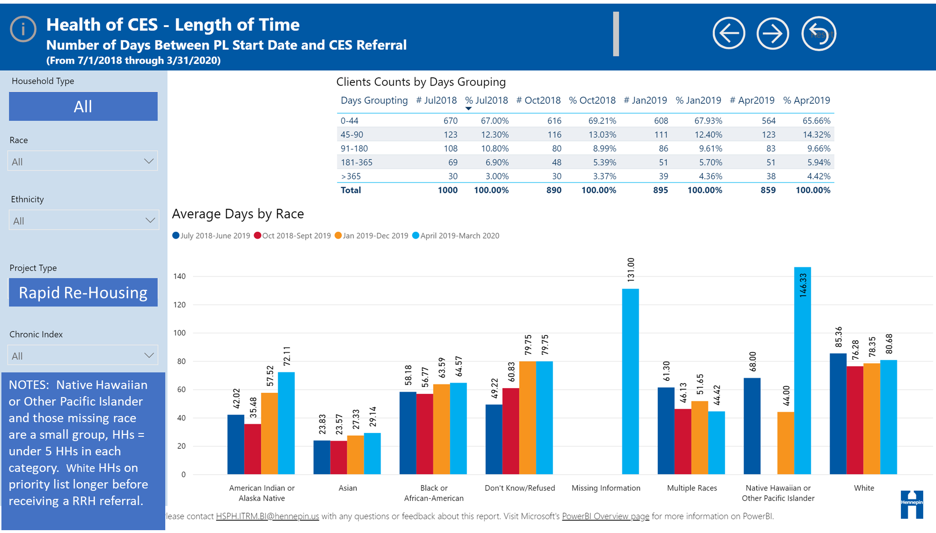

Slide 14
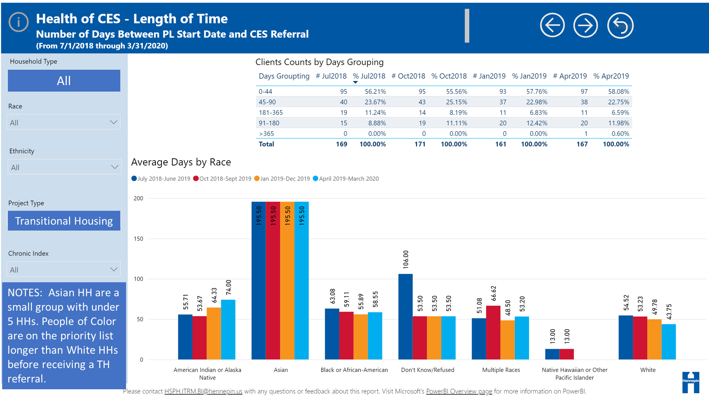

Slide 15
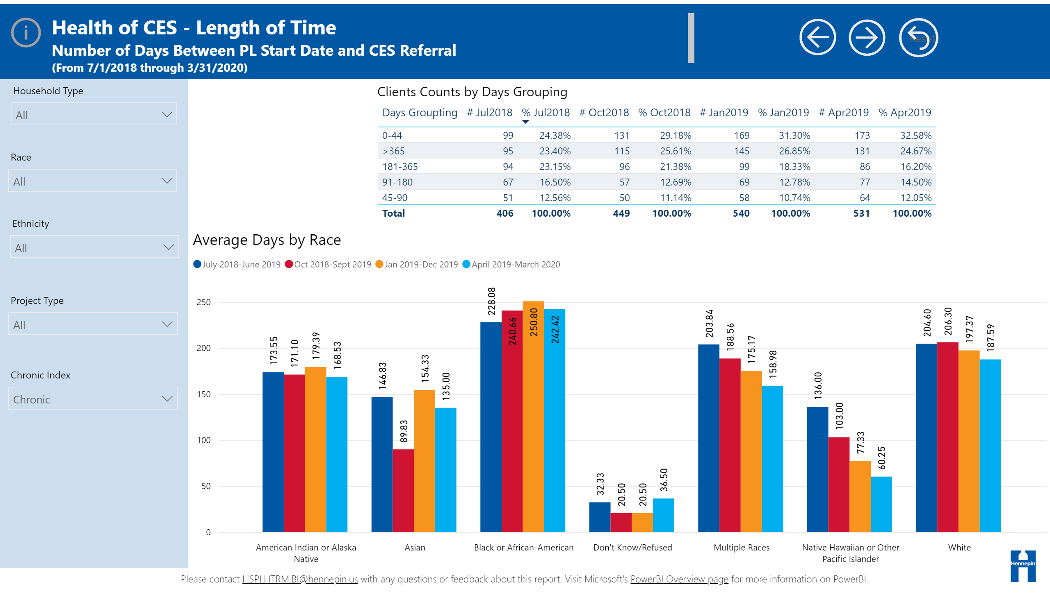
Start Date and Referral
Chronic
NOTES: Referrals for chronic HH took significantly longer for a successful referral than non-chronic in all race categories except Native Hawaiian.
Notes:
textbox
No alt text provided.
Back
No alt text provided.
actionButton
No alt text provided.
textbox
No alt text provided.
basicShape
No alt text provided.
image
No alt text provided.
textbox
No alt text provided.
slicer
No alt text provided.
Clients Counts by Days Grouping
No alt text provided.
slicer
No alt text provided.
Average Days by Race
No alt text provided.
slicer
No alt text provided.
slicer
No alt text provided.
slicer
No alt text provided.
textbox
No alt text provided.
Reset
No alt text provided.
Forward
No alt text provided.

Slide 16
Definition– Referral to Project entry
The following notes refer to slides 15-18.
Referral to project entry is the number of days between the CES referral to a housing provider and that housing provider entering them into their program.
Time periods reviewed are:
  July 2018 – June 2019
  October 2018 – September 2019
  January 2019 – December 2019
  April 2019 – March 23, 2020

Slide 17
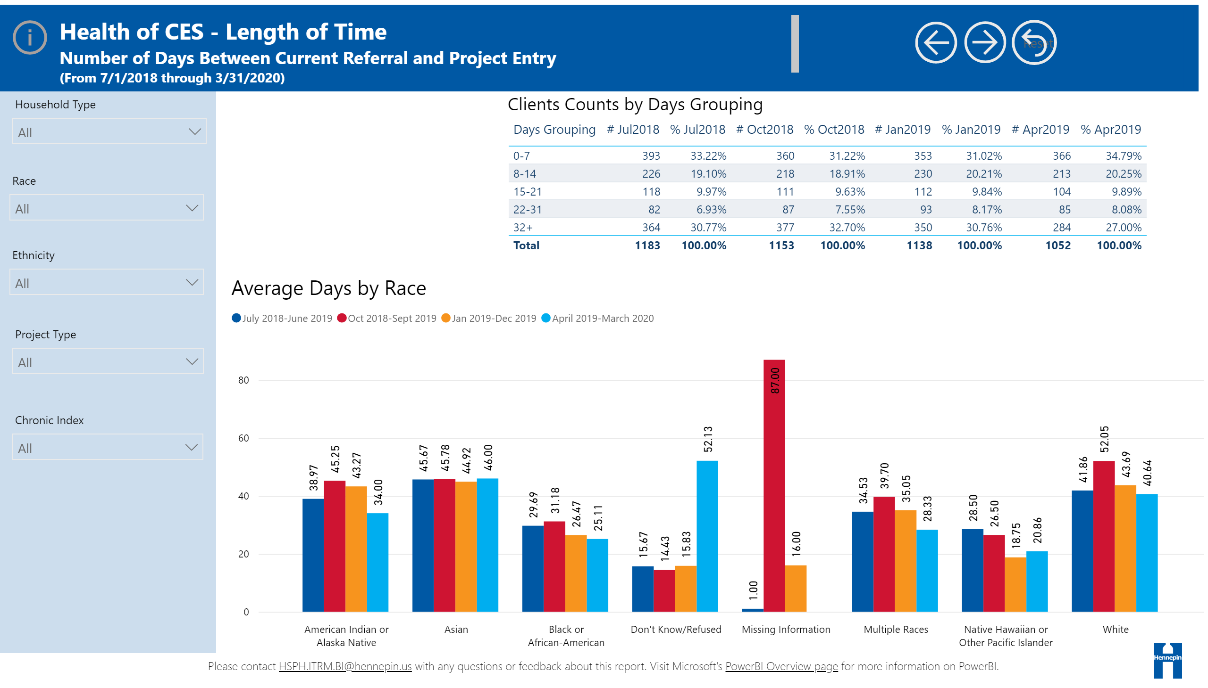
All
NOTES: Don't Know/Refused HHs = 8. White HHs (220) and Asian HHs (10) have longer average days between CES referral and project entry.

Slide 18
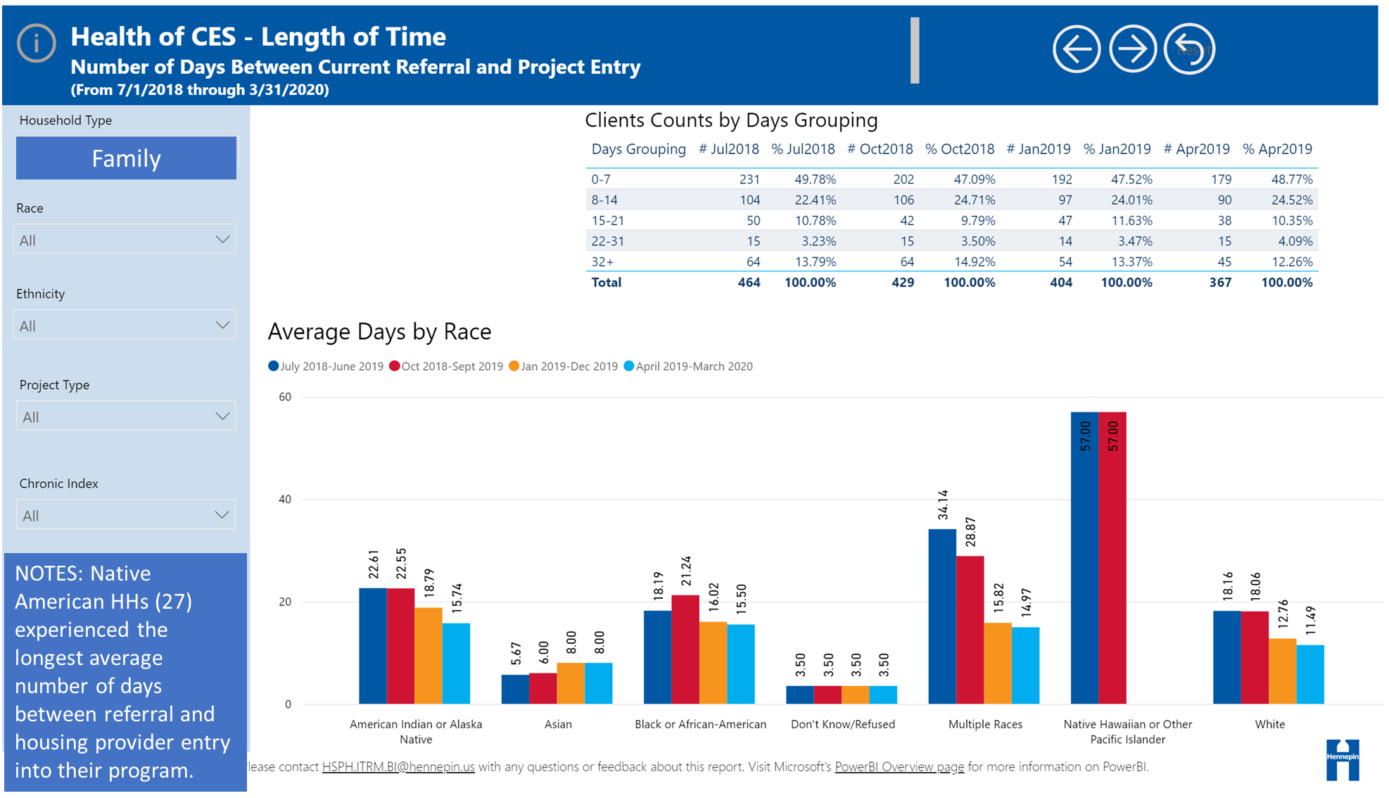

Slide 19
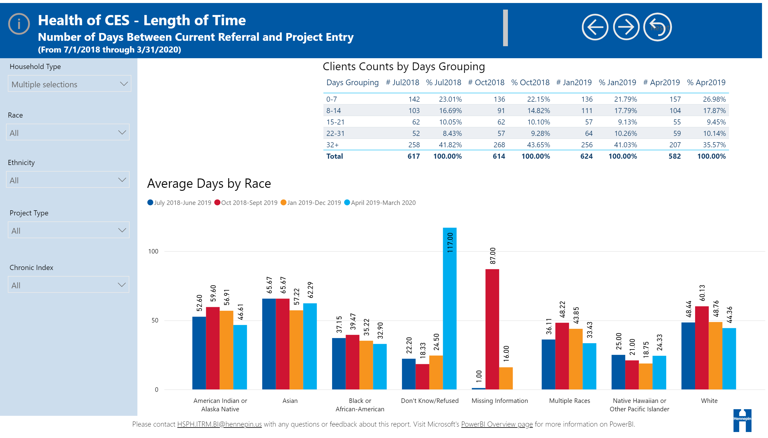
Single
NOTES: Single HHs have, on average, a longer length of time between CES referral and provider entry date than families.

Slide 20
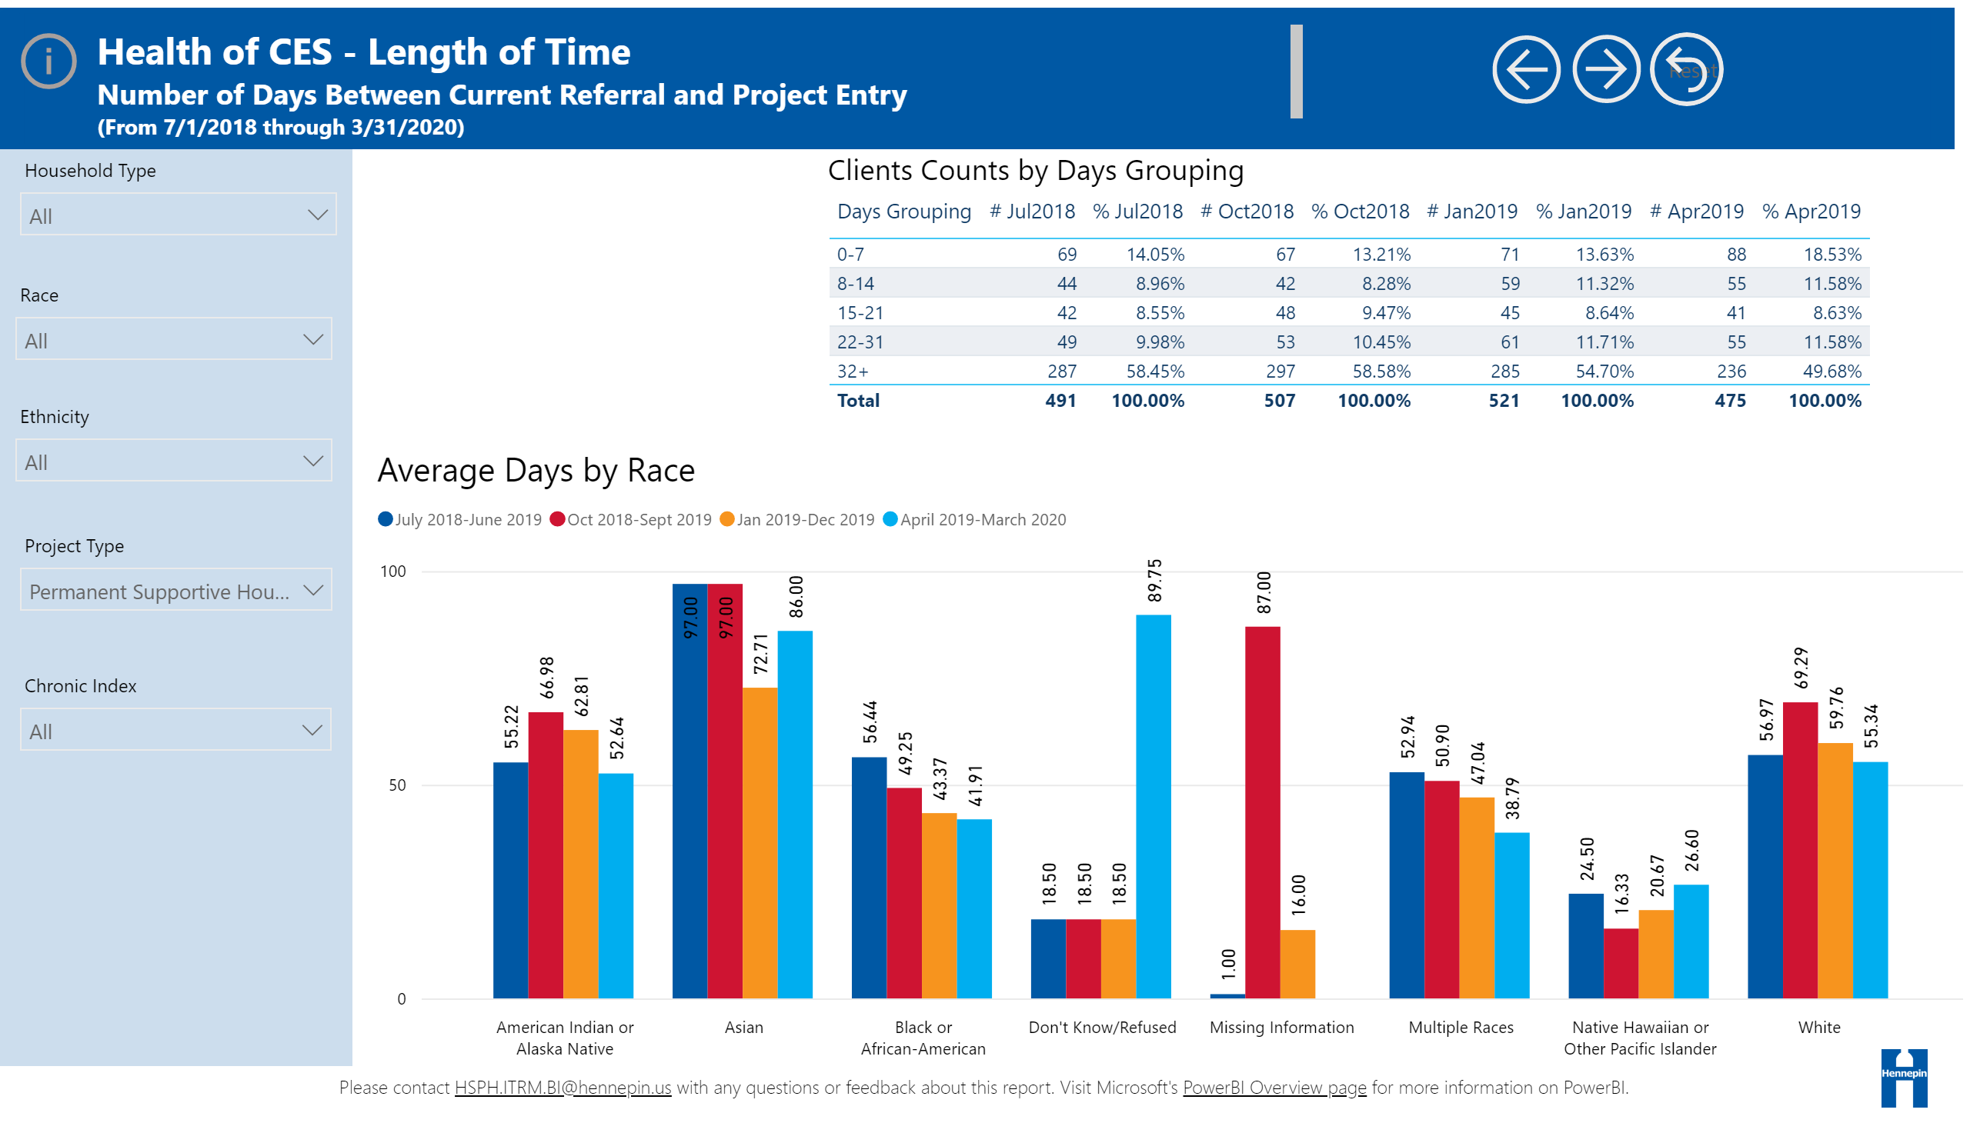
Permanent Supportive Housing
NOTES: Don’t know/refused and Asian household = 1% of HHs

Slide 21
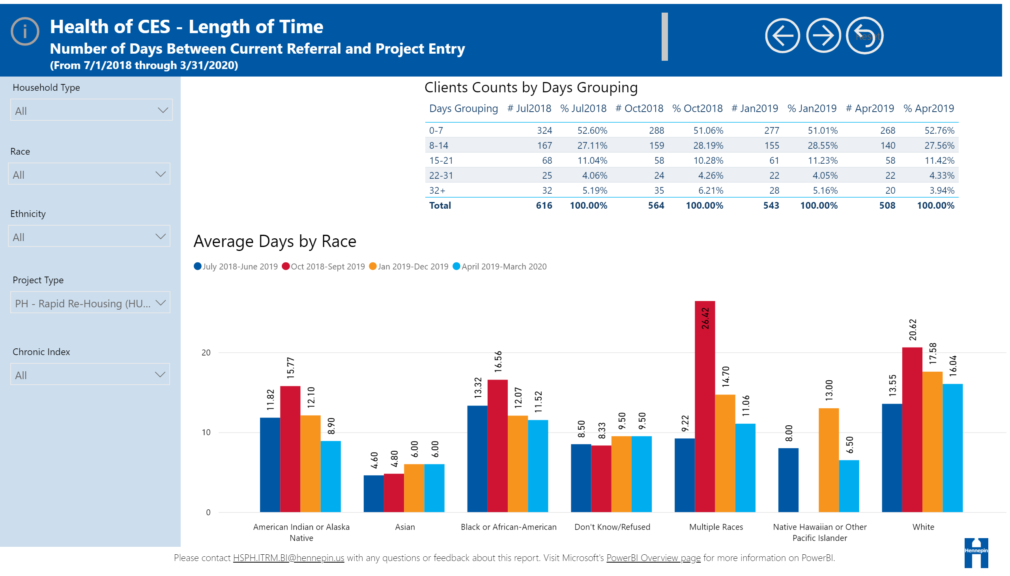
Referral and Project Entry
Rapid Re-Housing
NOTES: White HHs experienced the longest length of time between referral and project entry for Rapid Re-Housing.
Notes:
slicer
No alt text provided.
Average Days by Race
No alt text provided.
Clients Counts by Days Grouping
No alt text provided.
slicer
No alt text provided.
slicer
No alt text provided.
slicer
No alt text provided.
textbox
No alt text provided.
Reset
No alt text provided.
Forward
No alt text provided.
Back
No alt text provided.
textbox
No alt text provided.
actionButton
No alt text provided.
textbox
No alt text provided.
basicShape
No alt text provided.
image
No alt text provided.
textbox
No alt text provided.
slicer
No alt text provided.

Slide 22
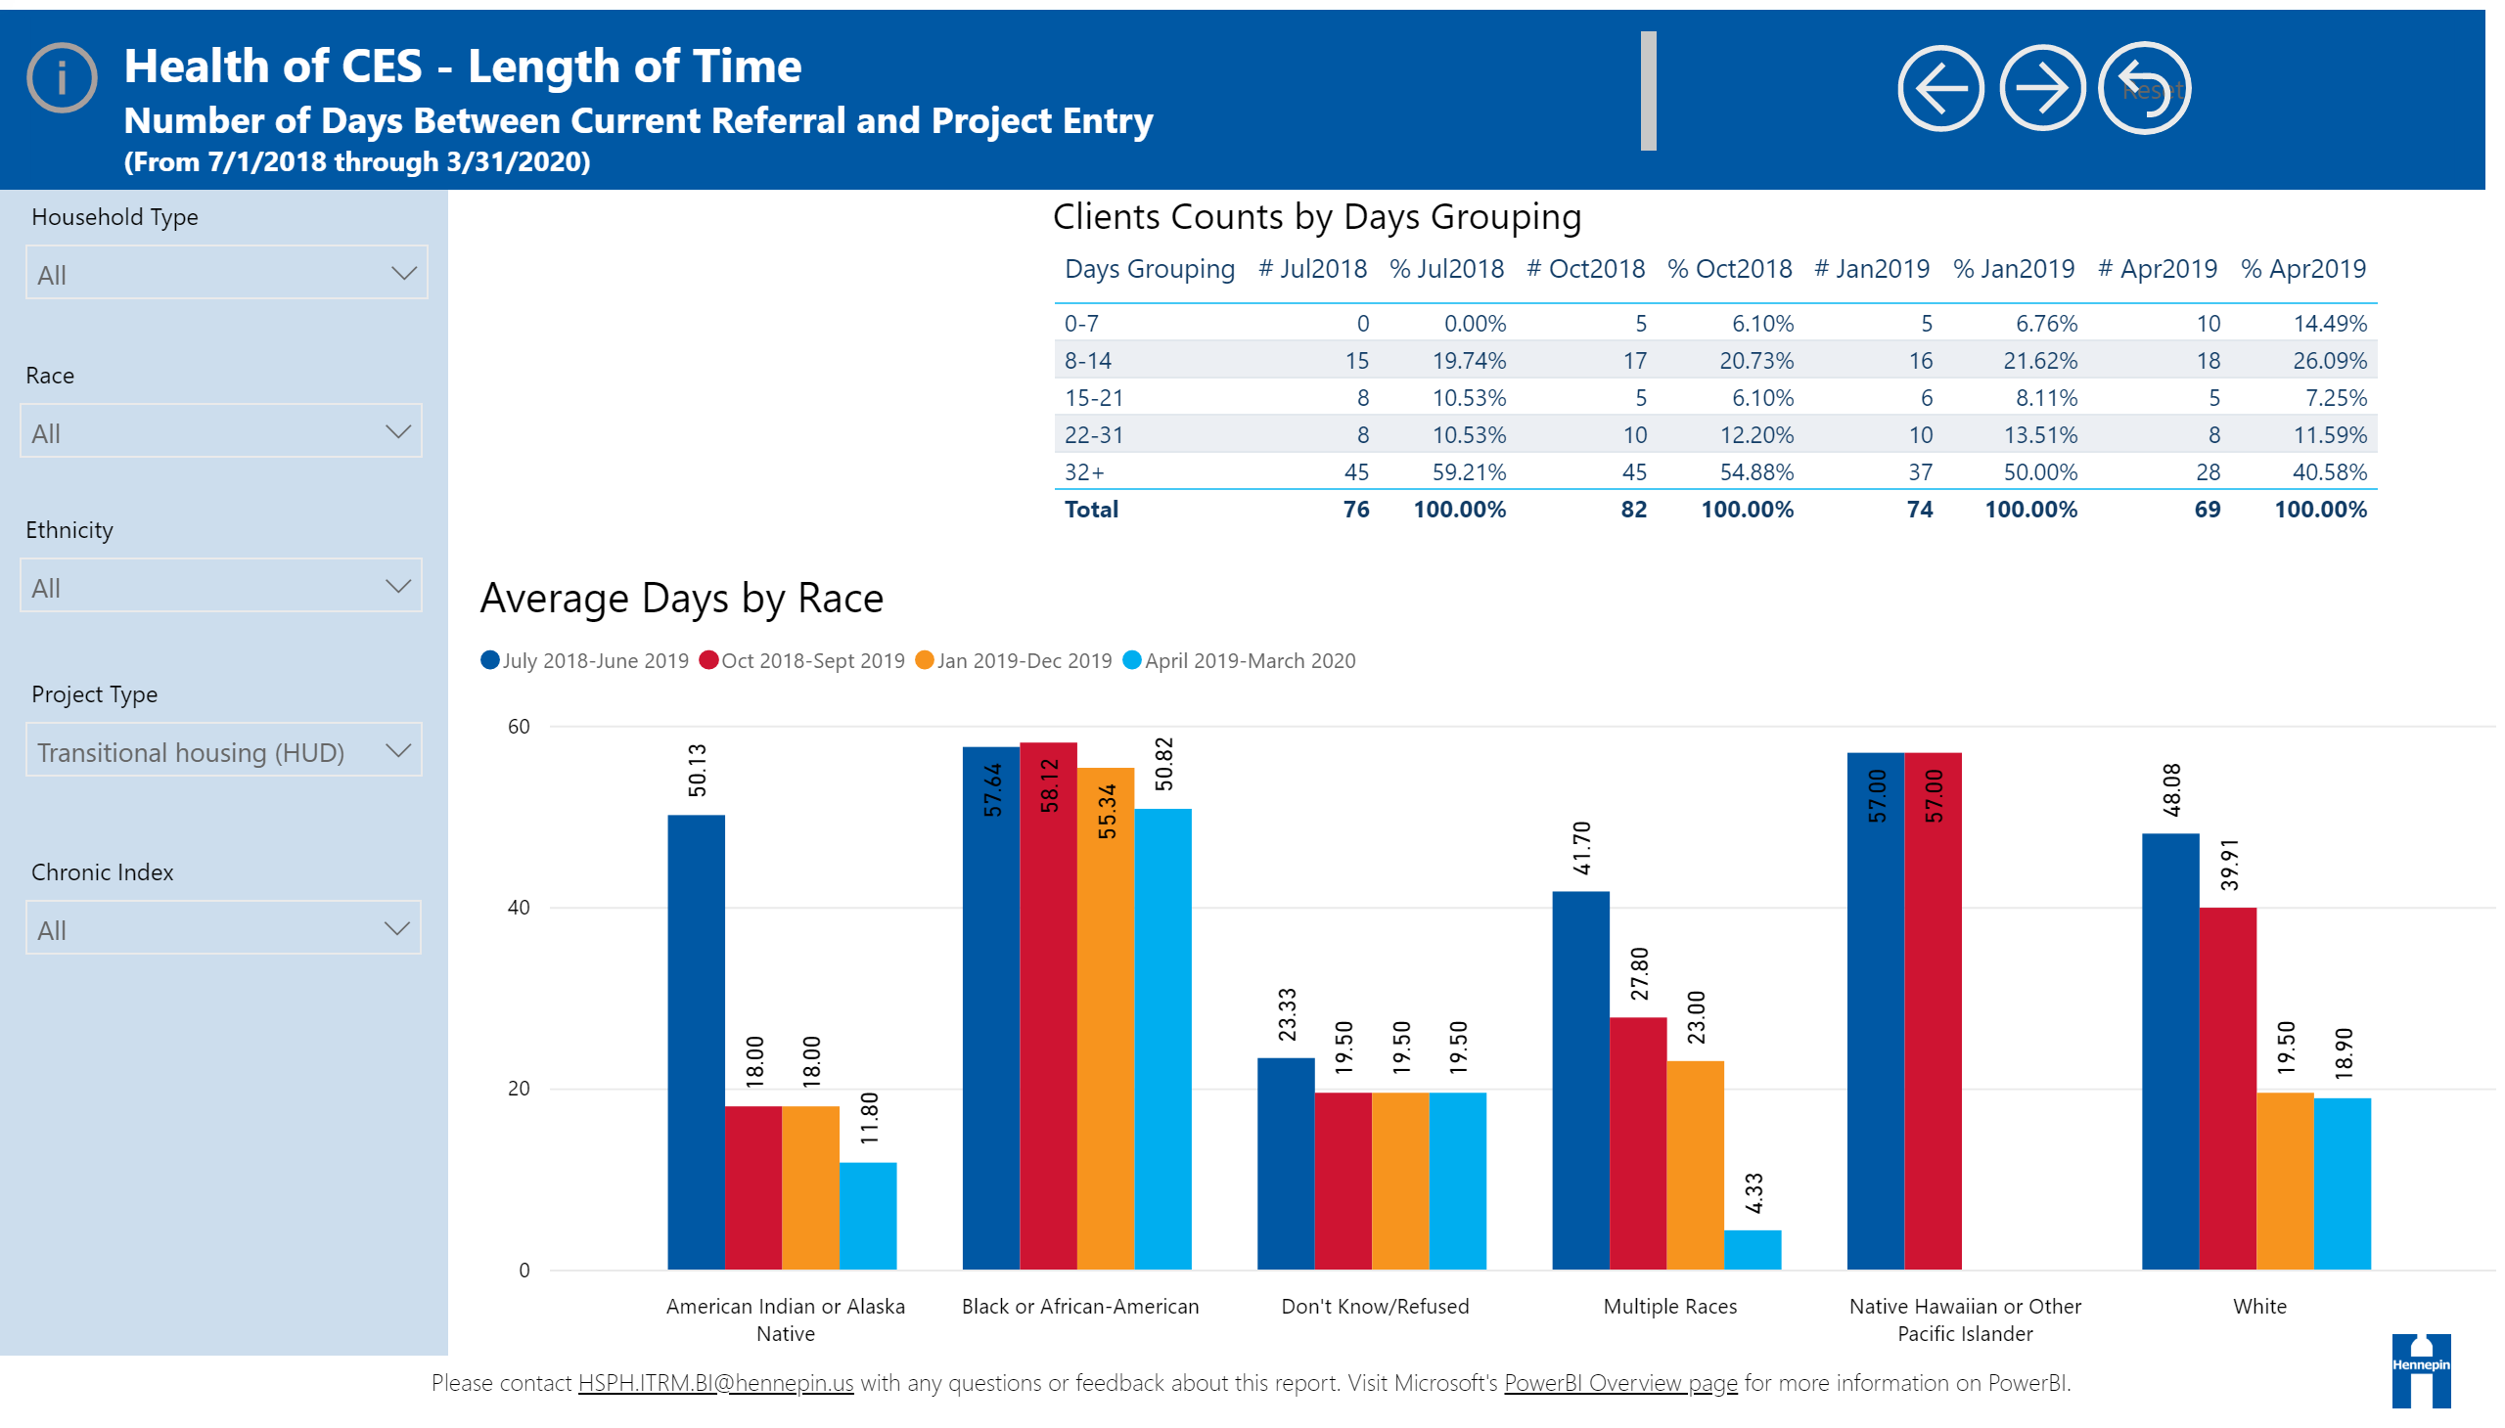
Referral and Project Entry
Transitional Housing
NOTES: Black or African American HHs experience the longest length of time between referral and project entry for Transitional Housing.
Notes:
slicer
No alt text provided.
Average Days by Race
No alt text provided.
Clients Counts by Days Grouping
No alt text provided.
slicer
No alt text provided.
slicer
No alt text provided.
slicer
No alt text provided.
textbox
No alt text provided.
Reset
No alt text provided.
Forward
No alt text provided.
Back
No alt text provided.
textbox
No alt text provided.
actionButton
No alt text provided.
textbox
No alt text provided.
basicShape
No alt text provided.
image
No alt text provided.
textbox
No alt text provided.
slicer
No alt text provided.

Slide 23
Definition– PL Start Date to Housed
The following notes refer to slides 20-25.
Priority start date to housed is the number of days between a household being added to the priority list and being housed by a housing provider.
Time periods reviewed are:
  July 2018 – June 2019
  October 2018 – September 2019
  January 2019 – December 2019
  April 2019 – March 23, 2020

Slide 24
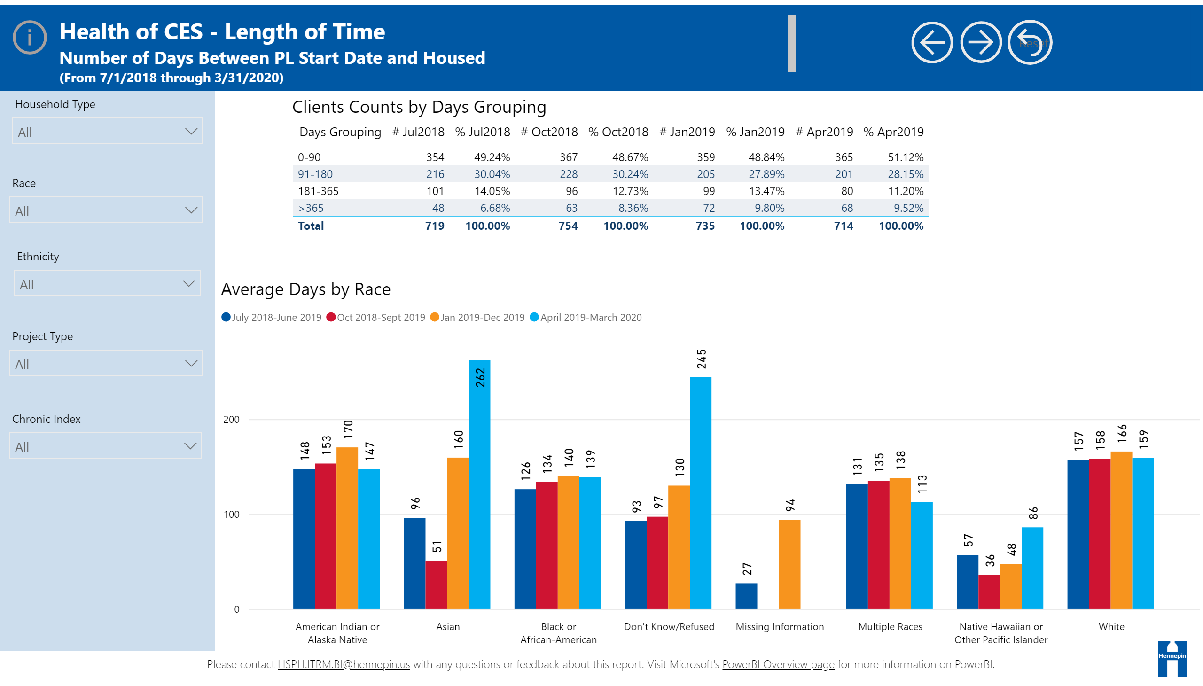
All
NOTES: Asian and Don’t know refused race are a small group with under 1% of all HHs. The average number of days to house White HHs was higher than Native Americans, Black/African American, and Multiple Race HHs.

Slide 25
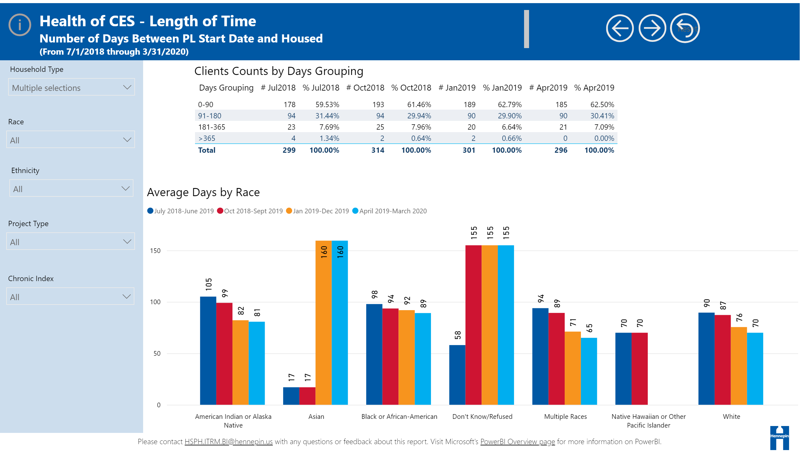
Family
NOTES: Don’t Know/Refused HHs = under 5, Asian HHs = under 5. Overall, families who are people of color have higher lengths of time between priority list start date and date housed.

Slide 26
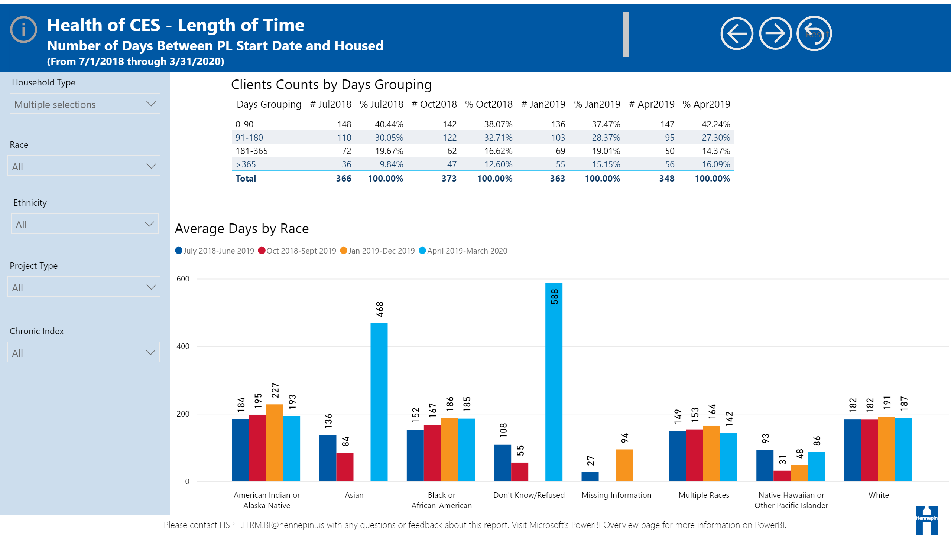

Single

Slide 27
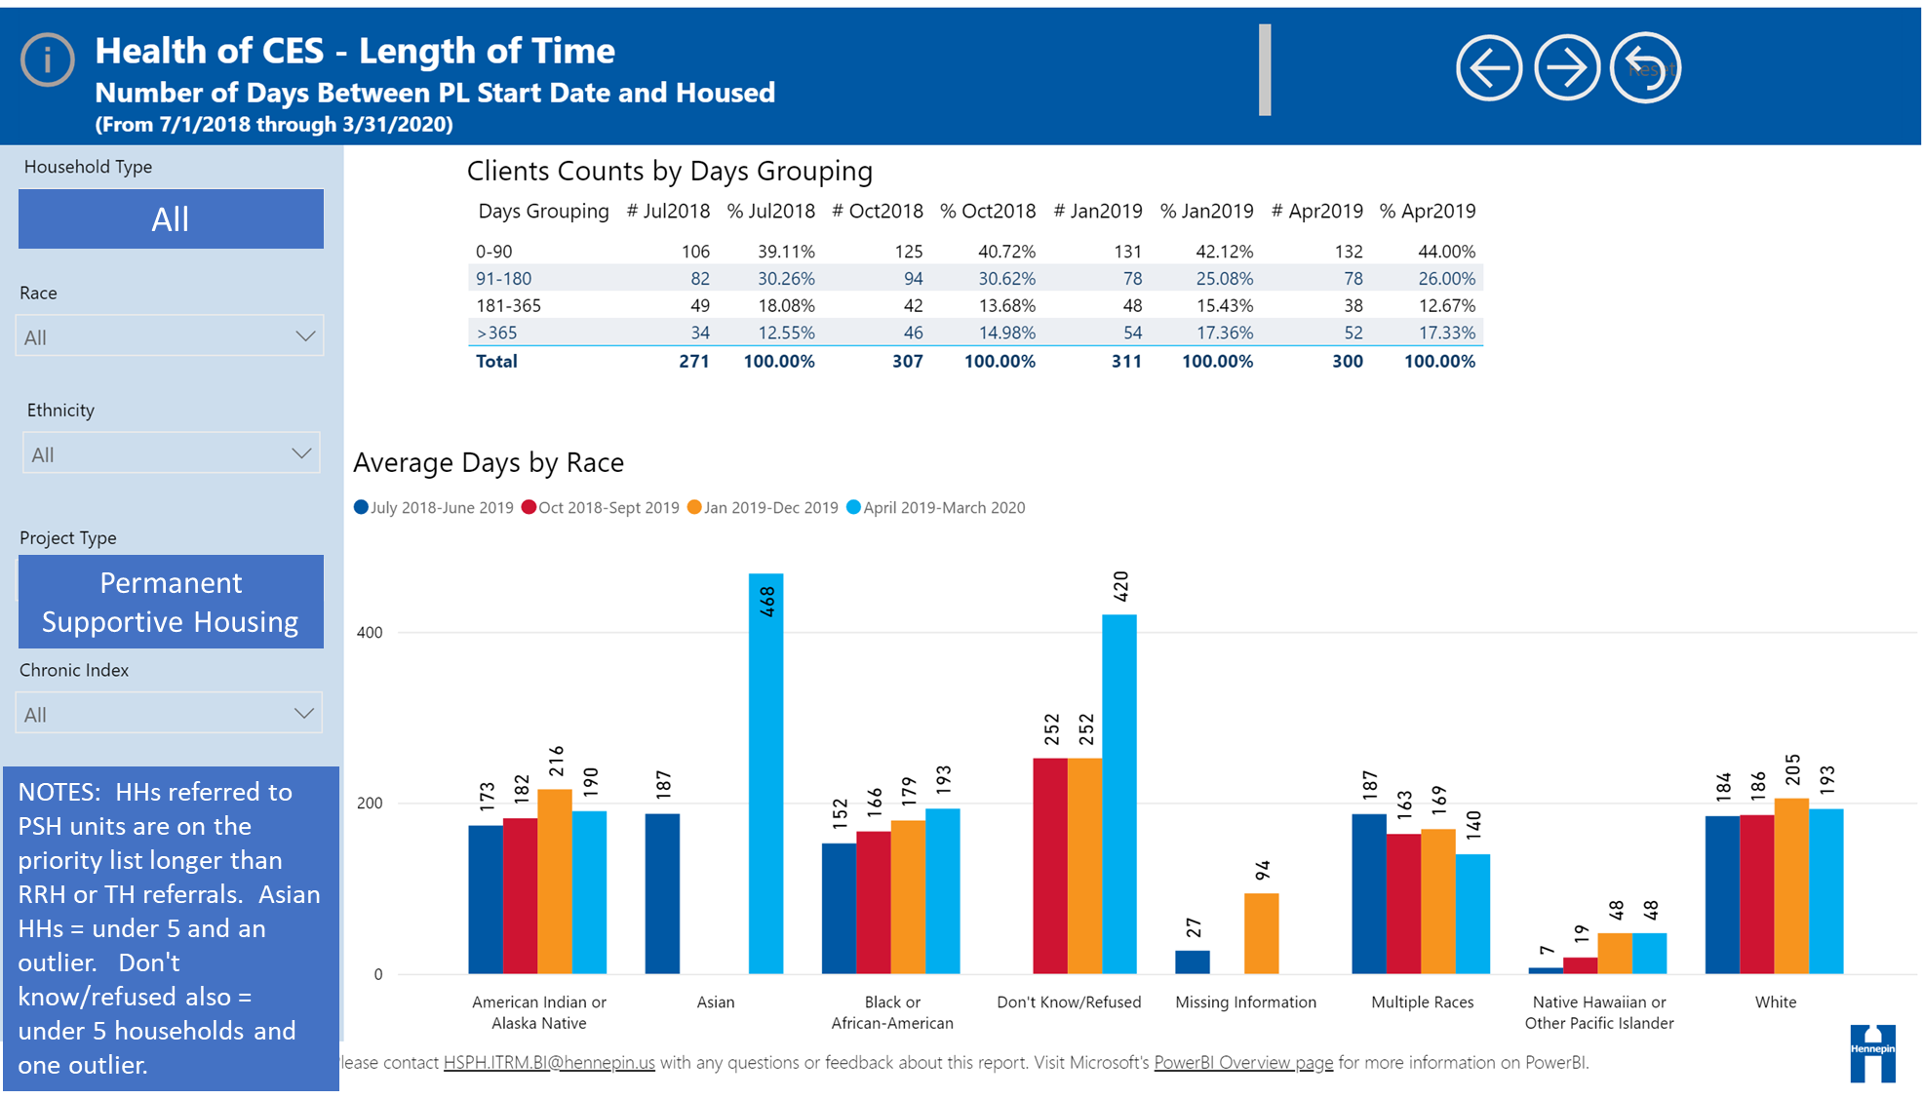

Slide 28
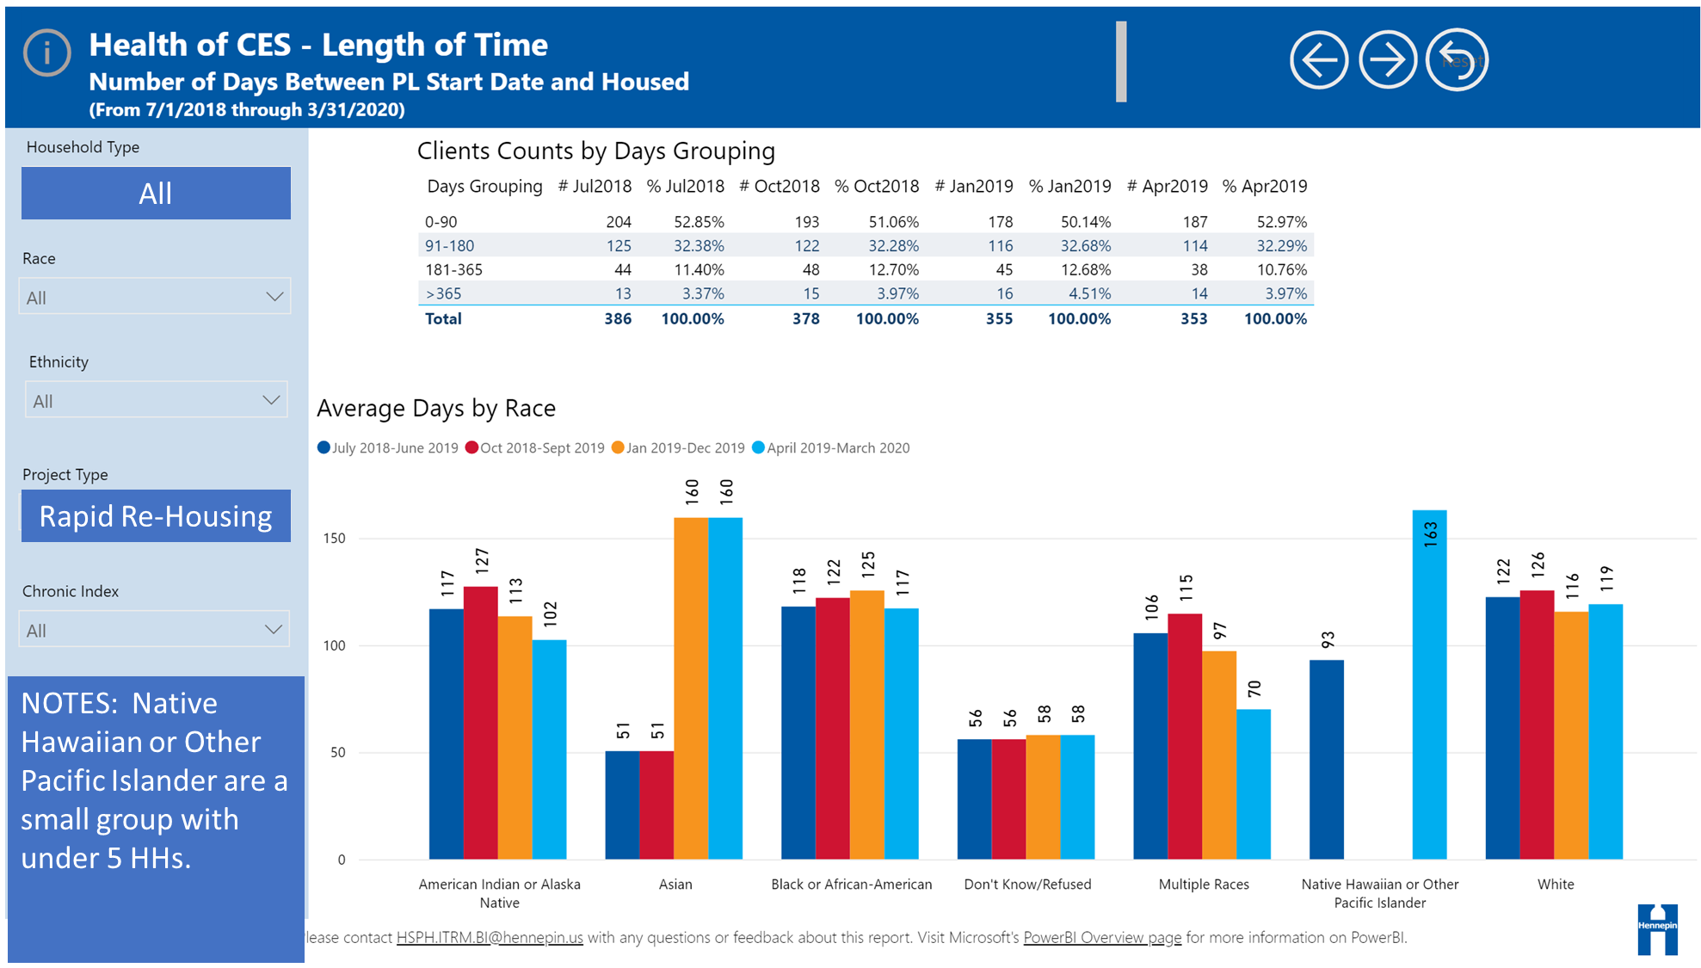
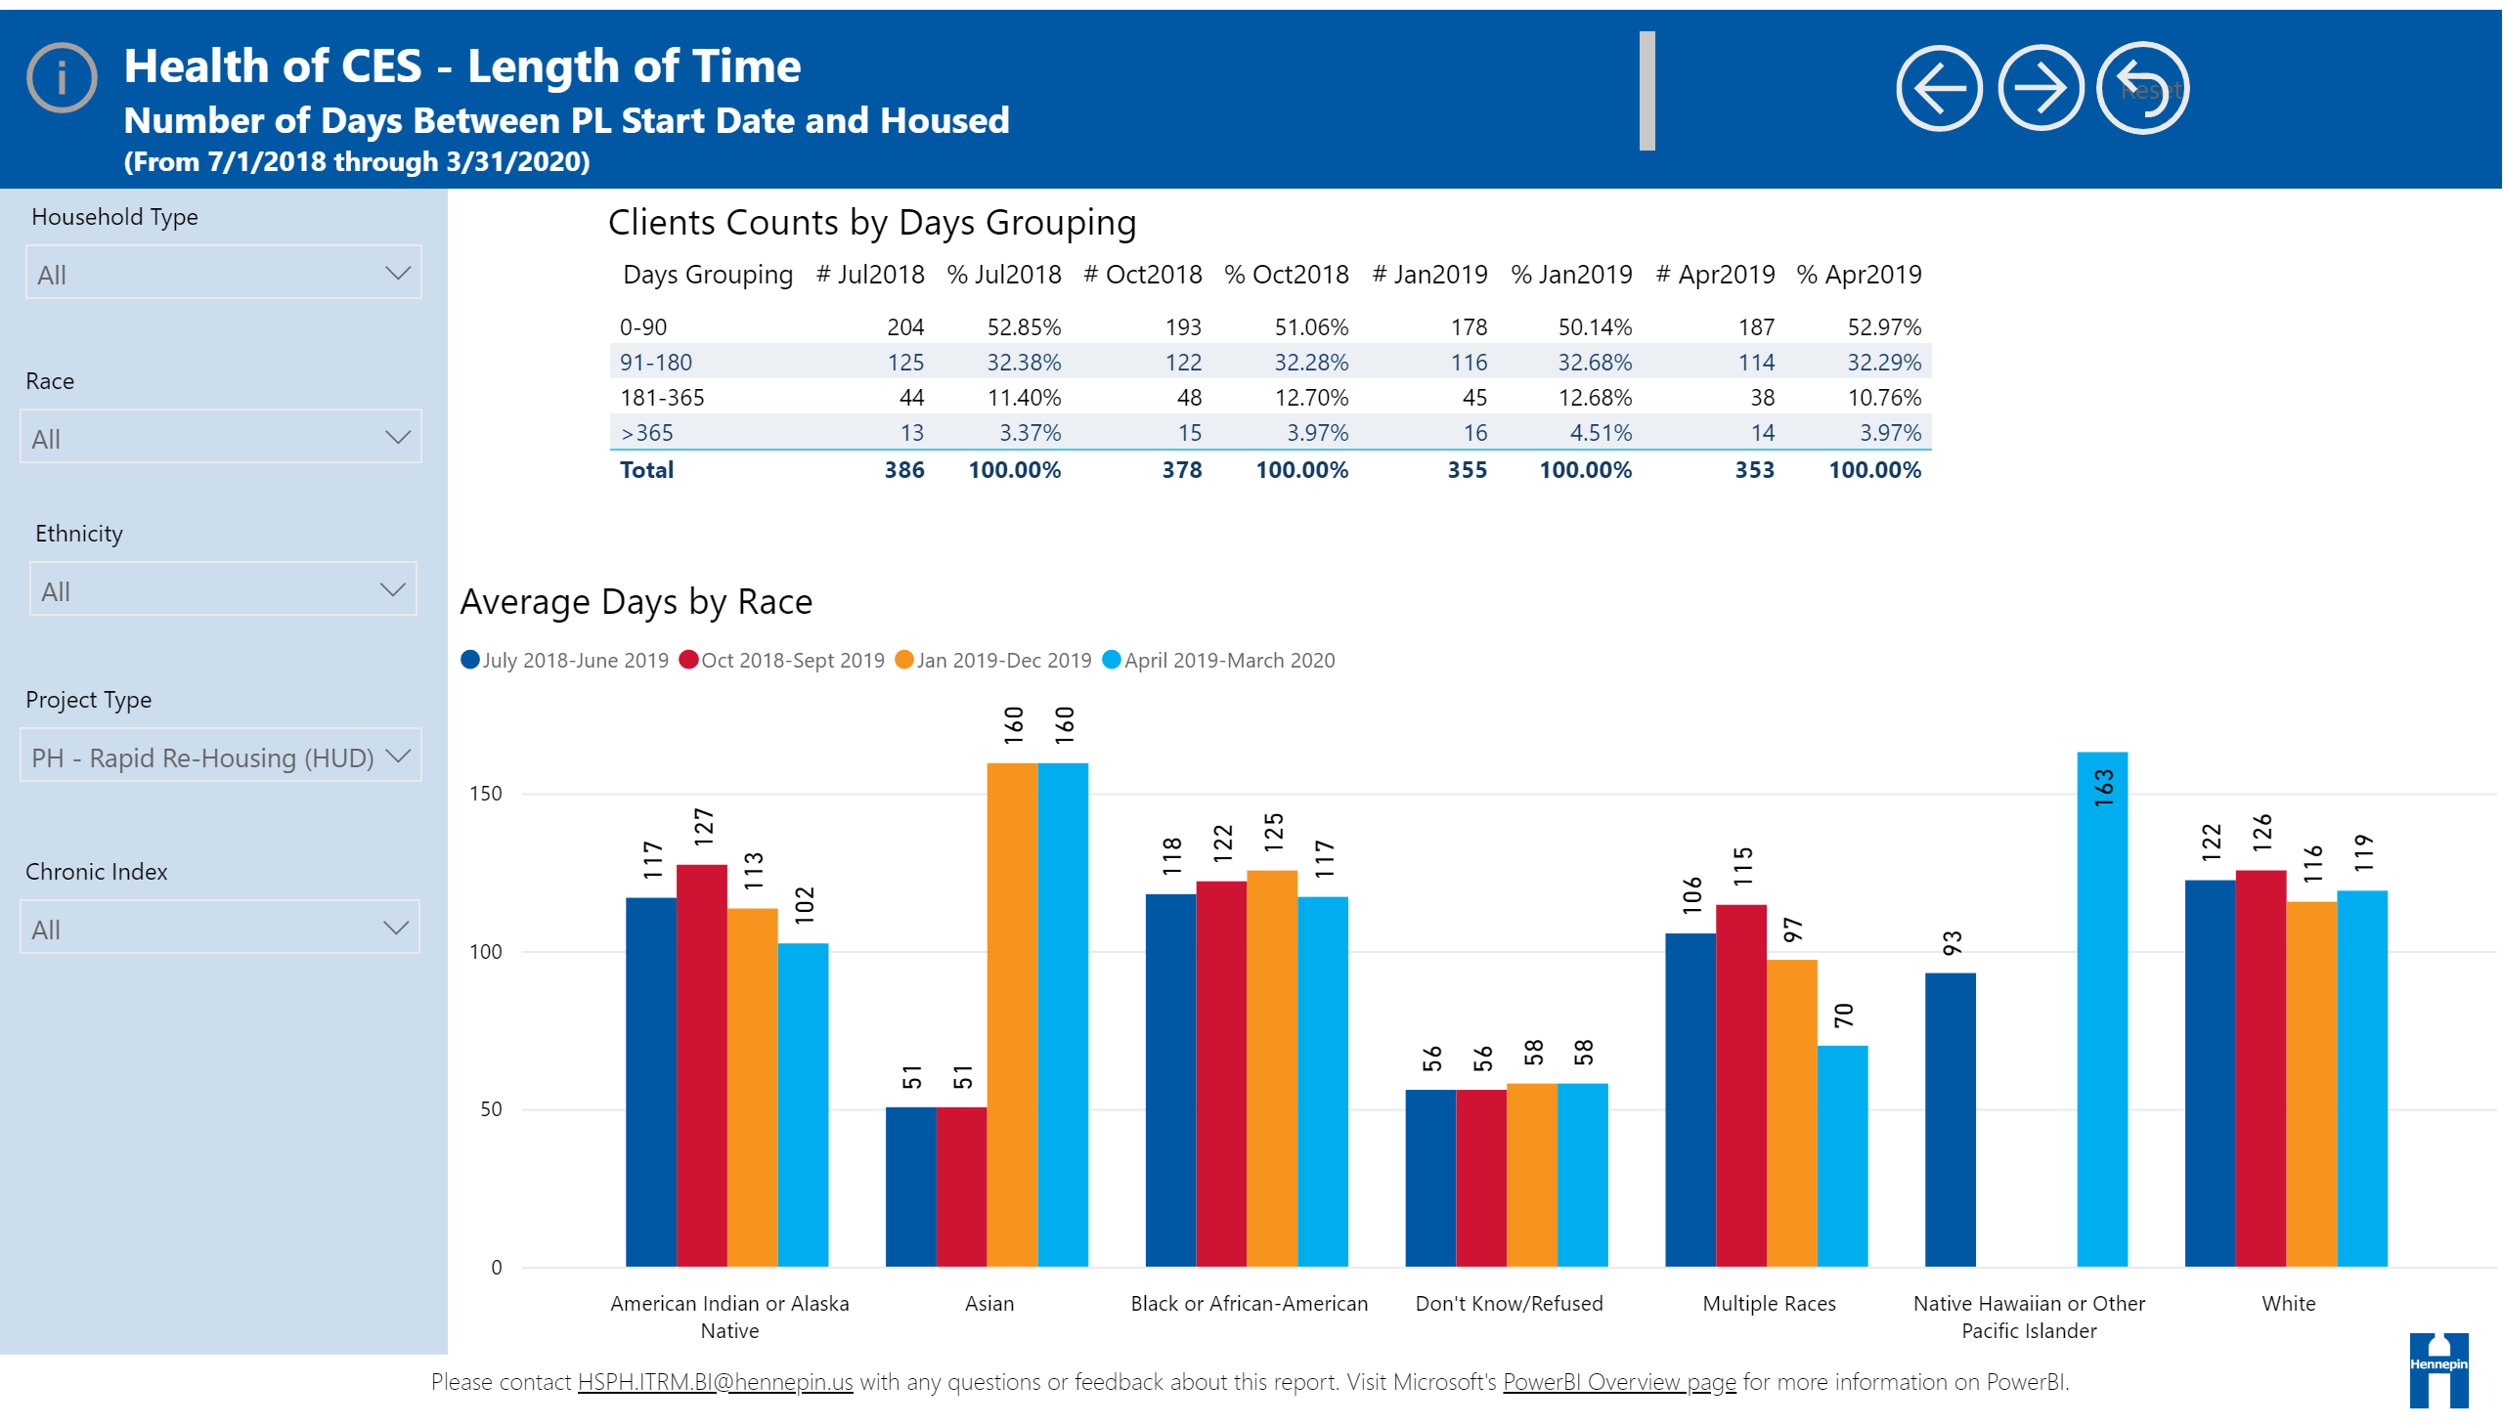
All
Rapid Re-Housing
NOTES: Native Hawaiian or Other Pacific Islander are a small group with under 5 HHs.

Slide 29
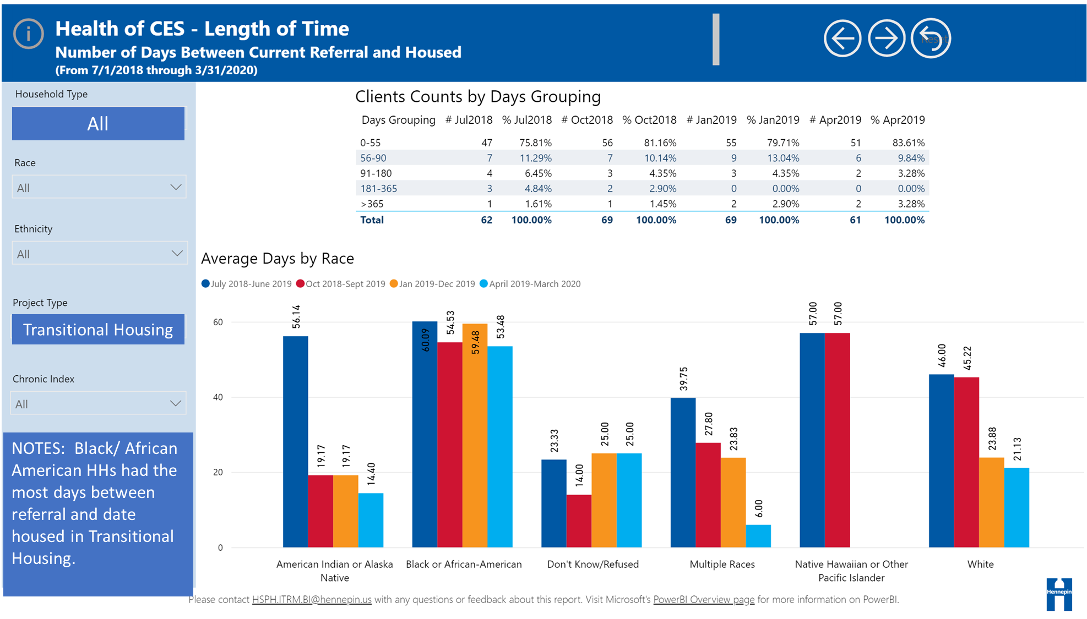

Slide 30
Definition– Current Referral to Housed
The following notes refer to slides 27-32.
Current Referral to Housed is the number of days between the CES referral to the provider and the date housed by the provider.
Time periods reviewed are:
  July 2018 – June 2019
  October 2018 – September 2019
  January 2019 – December 2019
  April 2019 – March 23, 2020

Slide 31
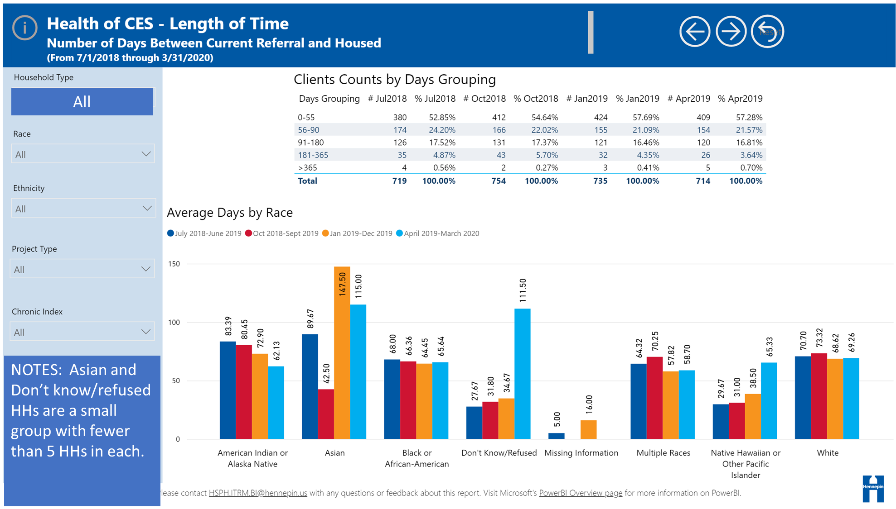

Slide 32
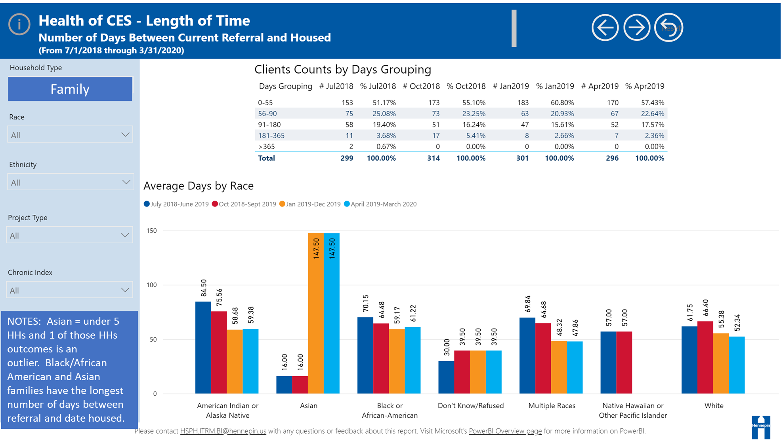

Slide 33
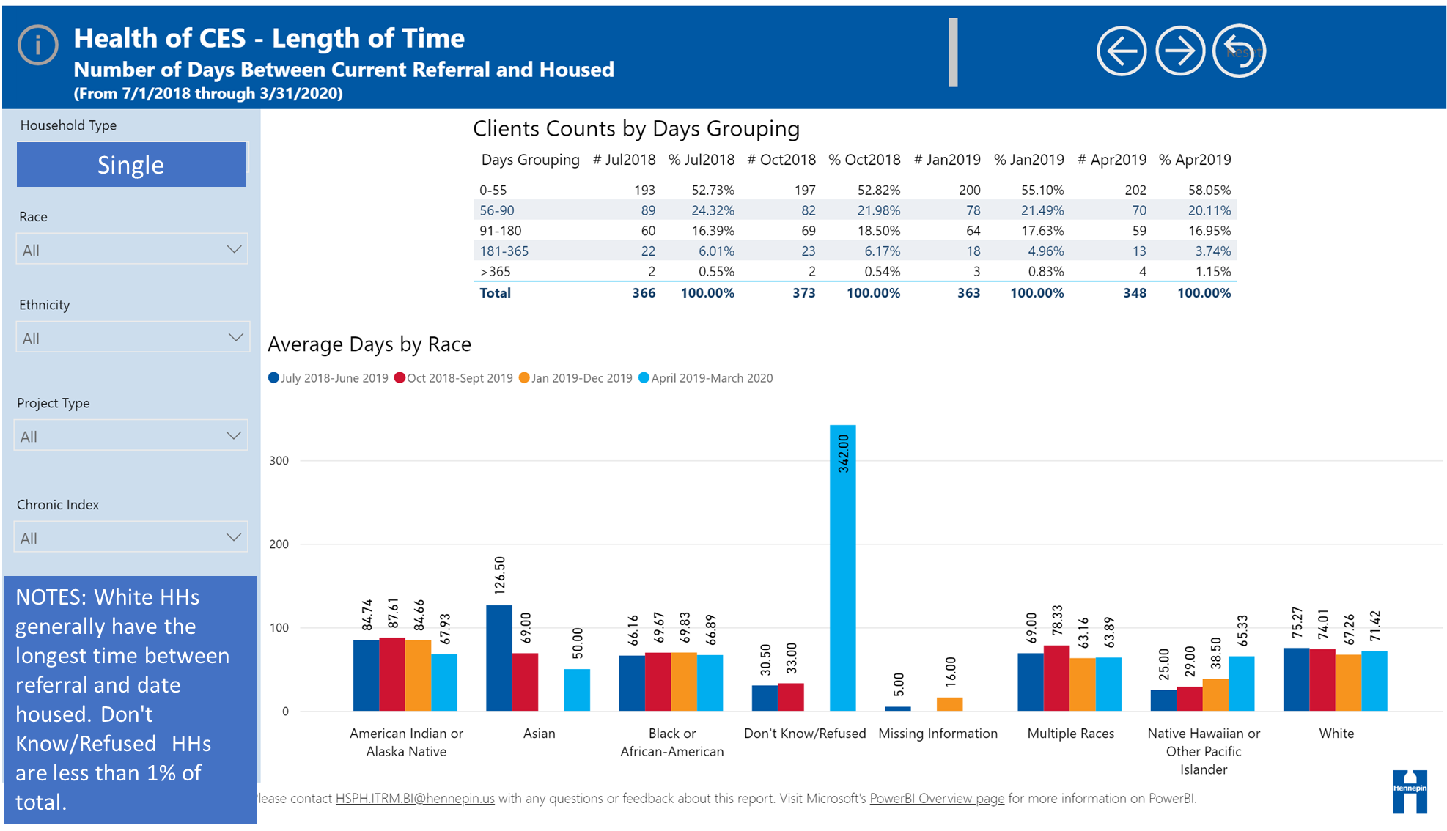

Slide 34
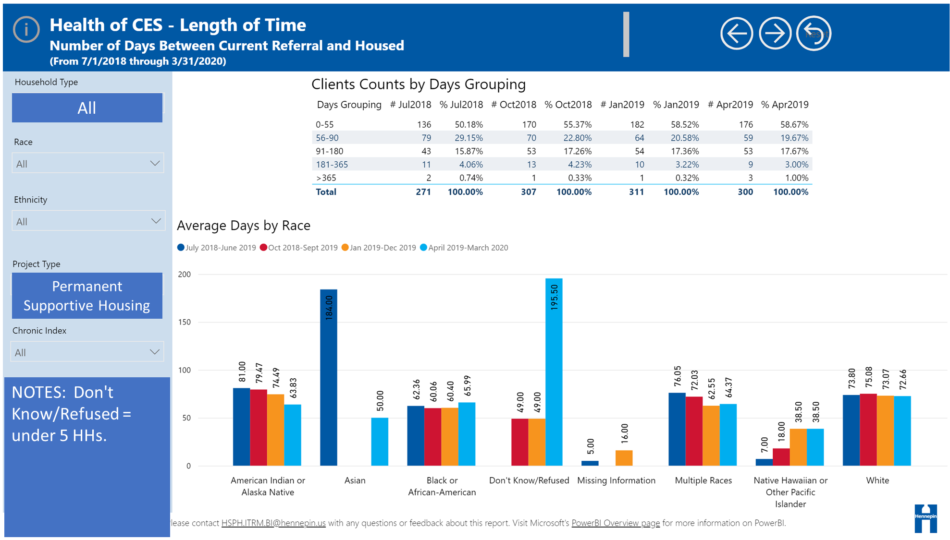

Slide 35
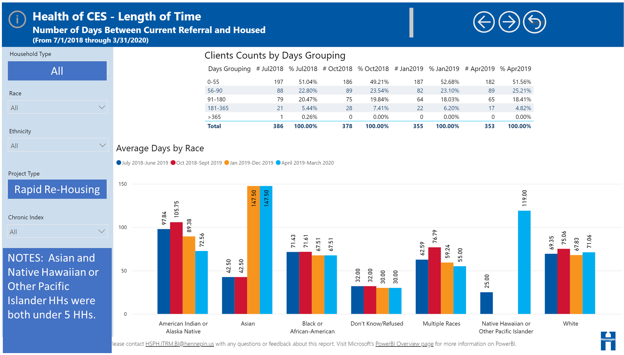

Slide 37
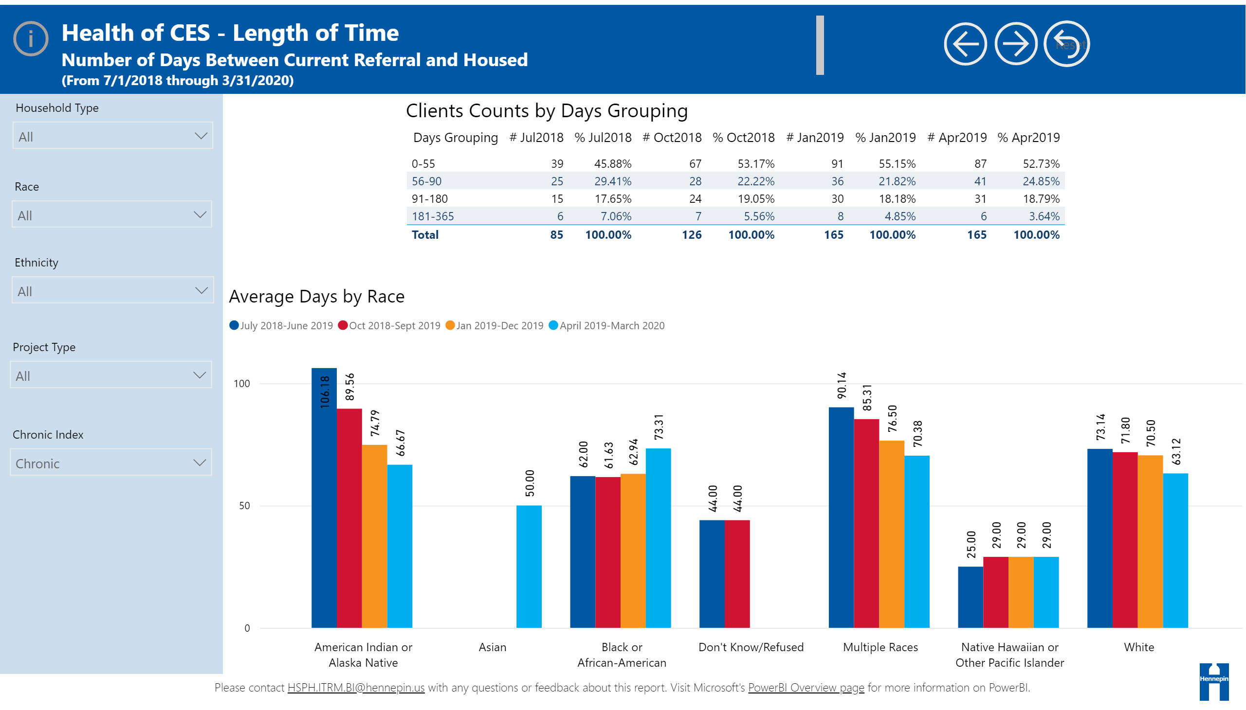
Referral and Housed
Chronic
NOTES: 165 Chronically homeless HHs. Black or African American chronic HHs experienced the longest length of time between referral and date housed.
Notes:
slicer
No alt text provided.
Clients Counts by Days Grouping
No alt text provided.
Average Days by Race
No alt text provided.
slicer
No alt text provided.
slicer
No alt text provided.
slicer
No alt text provided.
textbox
No alt text provided.
Reset
No alt text provided.
Forward
No alt text provided.
Back
No alt text provided.
textbox
No alt text provided.
actionButton
No alt text provided.
textbox
No alt text provided.
basicShape
No alt text provided.
image
No alt text provided.
textbox
No alt text provided.
slicer
No alt text provided.

Slide 38
Definition– Project Entry to Housed
The following notes refer to slides 34-36.
Project Entry to Housed is the number of days between the date the household was entered into the housing program and the date the household was housed.
Time periods reviewed are:
  July 2018 – June 2019
  October 2018 – September 2019
  January 2019 – December 2019
  April 2019 – March 23, 2020

Slide 39
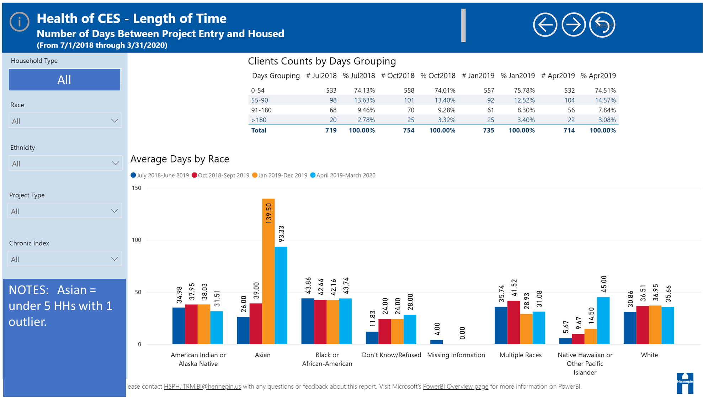

Slide 40
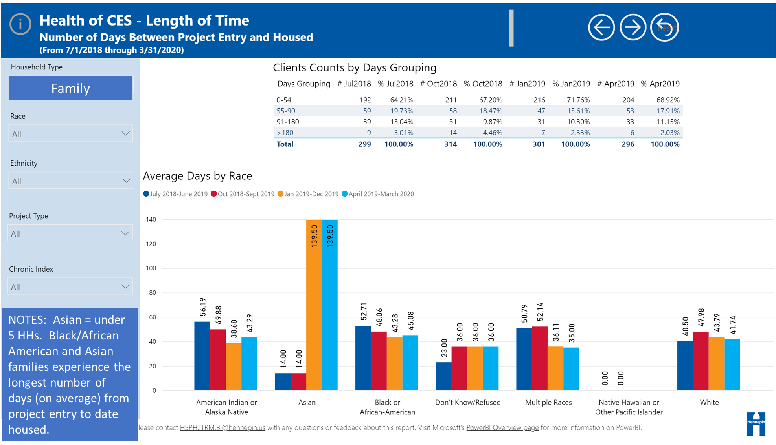

Slide 41
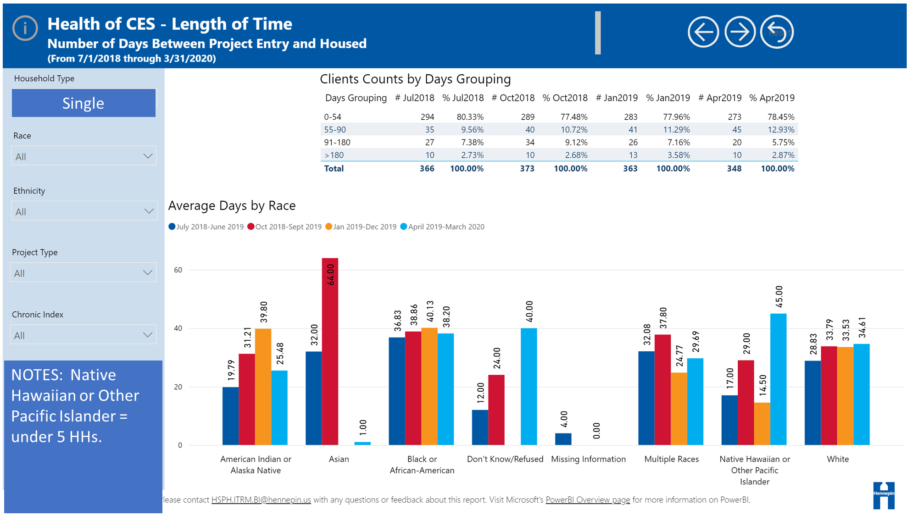

Slide 42
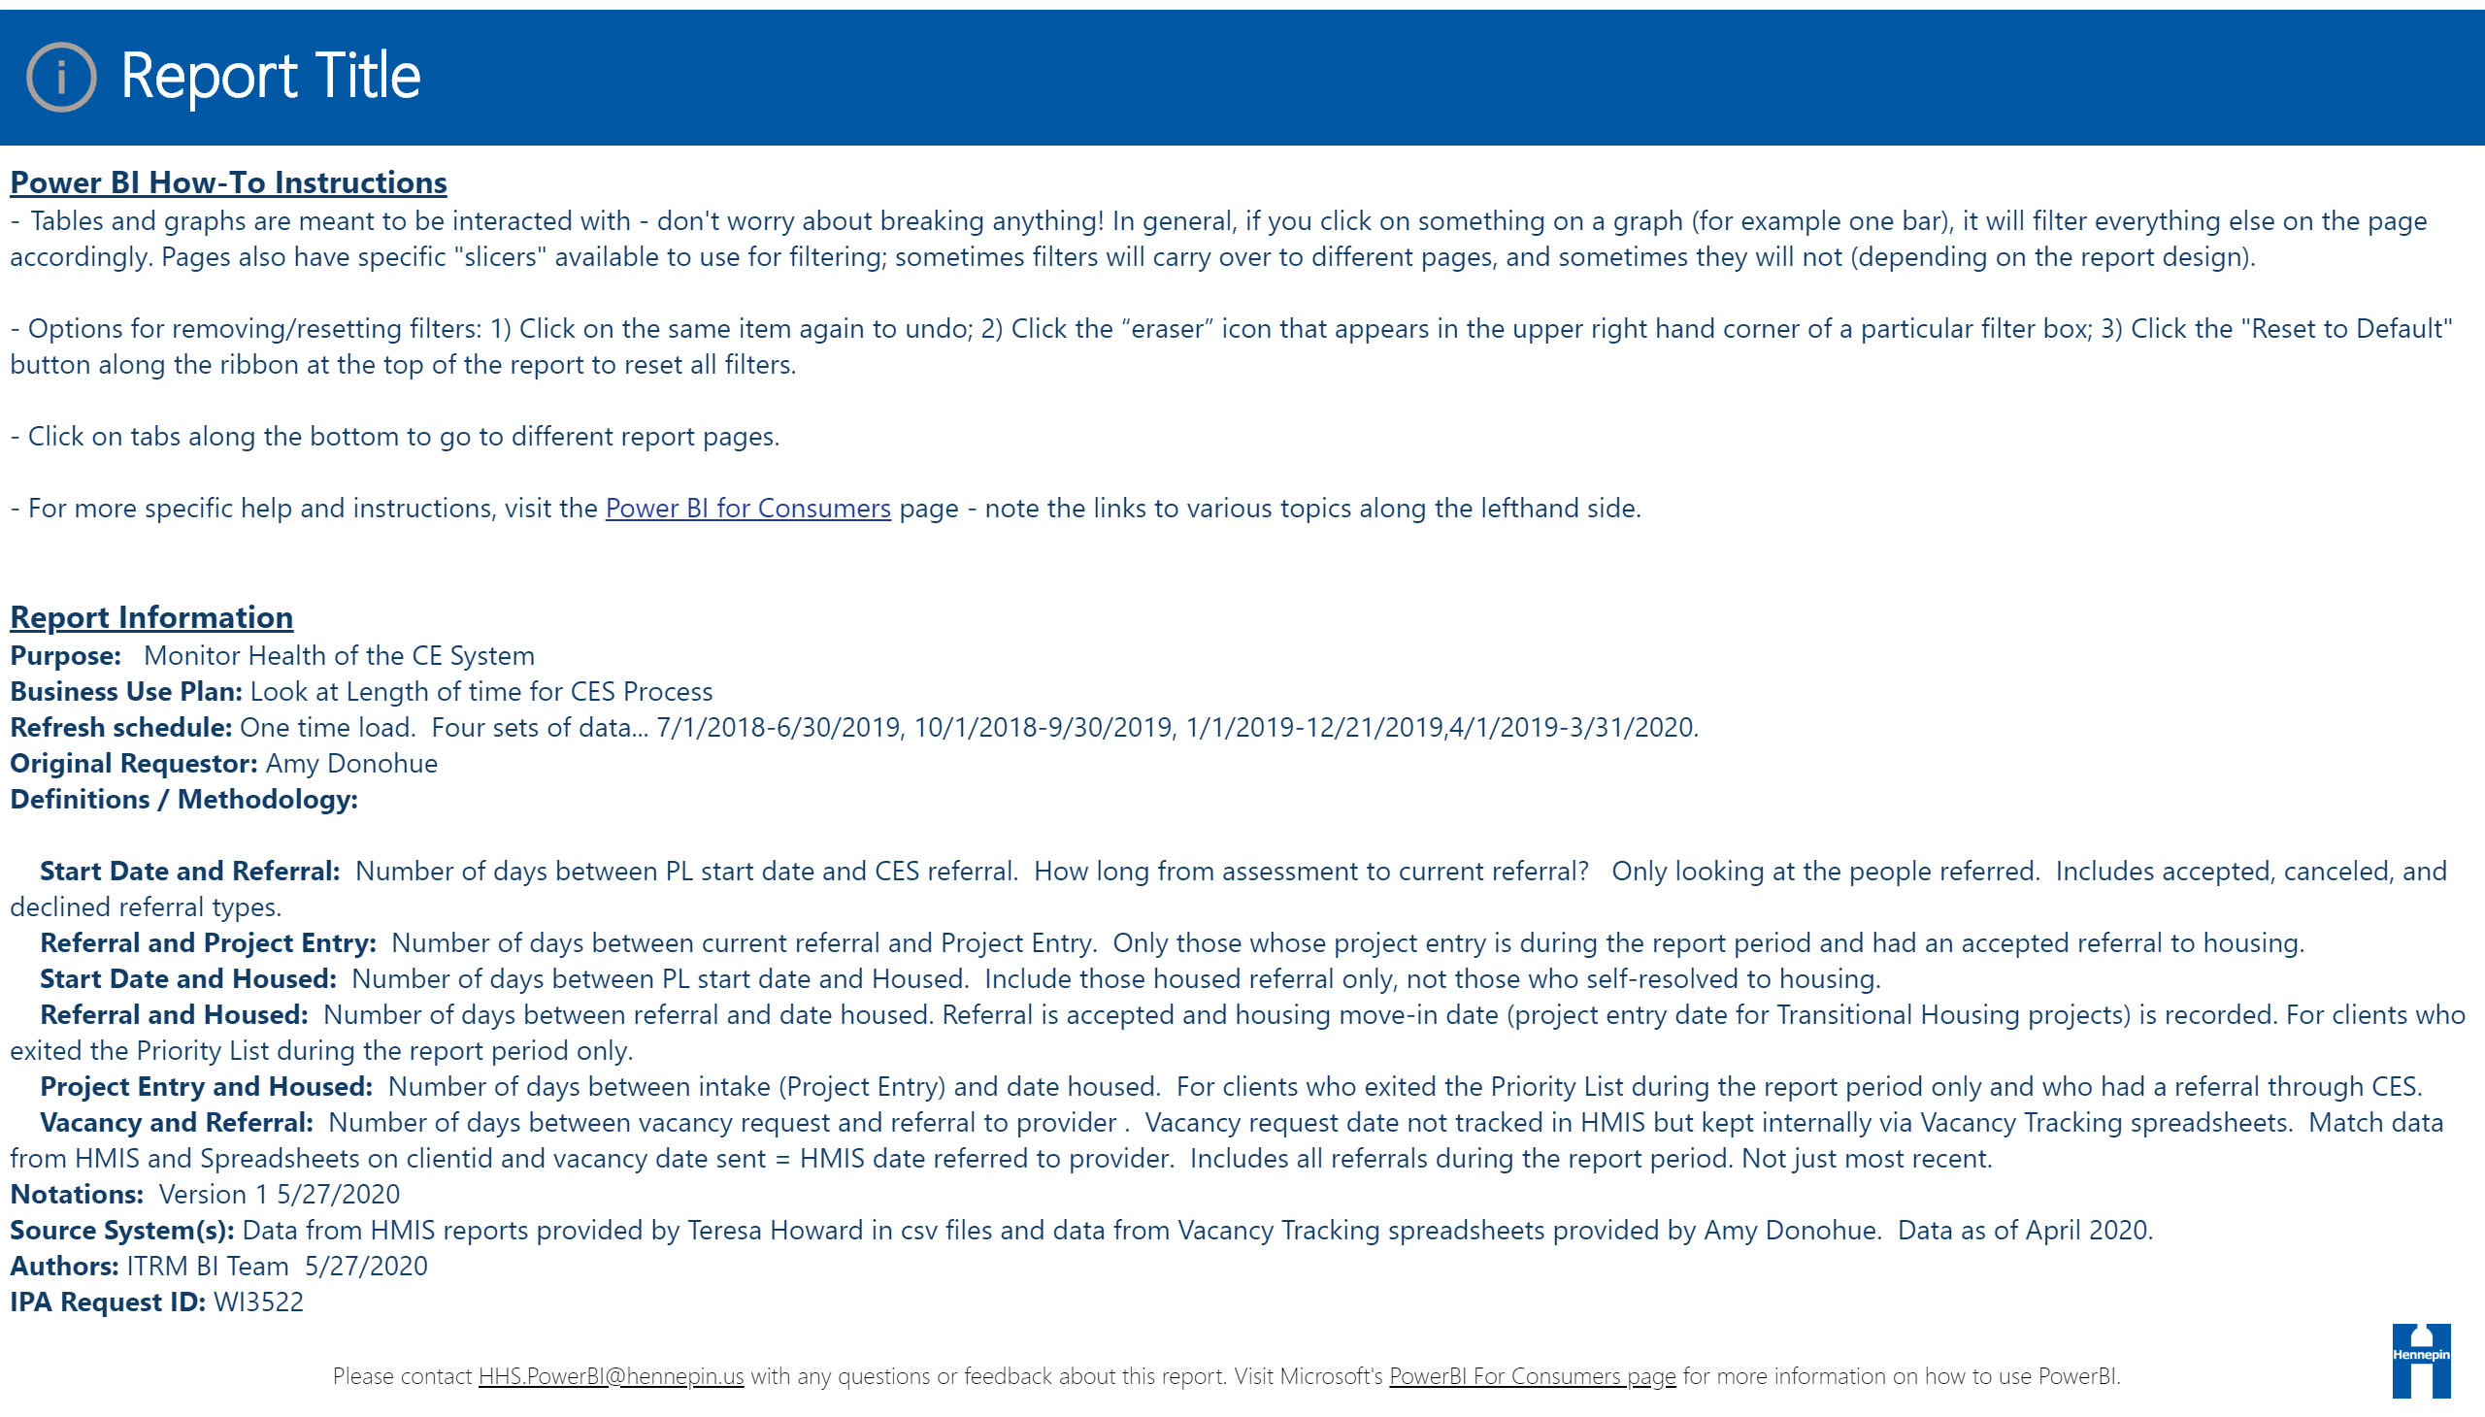

Slide 43
Amy Donohue
Amy.Donohue@hennepin.us,

