Slide 1
Adult Mental Health Initiative reform and disparity reduction
DHS prompted AMHI reform
Hennepin County Behavioral Health is aligning our efforts with disparity reduction
Notes:
Here to talk a little bit about AMHI reform and how it ties into our commitment at Hennepin to reduce disparities. Specifically, we have a goal to increase funding to culturally specific services to better serve residents.
As we have shared previously, we are working on requirements of the state’s reform and are participating in meetings about a new formula for distributing funds.
We are also looking at AMHI programs as part of our overall efforts to reduce disparities for Hennepin County residents.

Slide 2
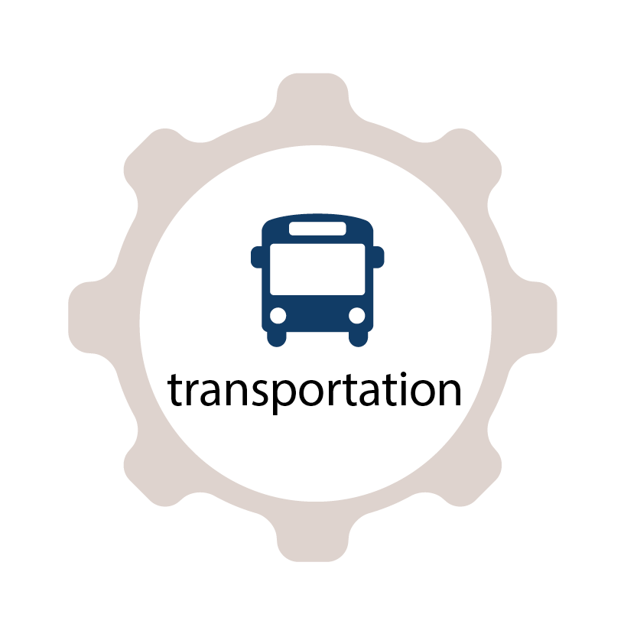
Mental health relates to all domains
Often live 25 fewer years
21% people experiencing homelessness have serious mental illness
Are more likely to have incomes less than $10,000
Have a higher rate of unemployment
Are 4 times more likely to be arrested for low level crimes
2 times more likely to drop out
Have more difficulty navigating their communities
Notes:
Pointing out what we all know. And, I think it’s important to keep in mind that disparities in mental health impact, of course, other areas of life.
It impacts disparities in housing, education, employment, justice, income and even the transportation.
Notes:
In 2020 Suicide was the second leading cause of death of people in MN between the ages of 18-34. American Indian/Alaska Native people had the highest rates of suicide of any racial/ethnic group in the US.
We see higher rate of unemployment. 76% of people with no mental illness are employed v. only 55% of people with serious mental illness.
MI results in $193.2 B in US annual lost earnings;
Some studies estimate that 70% kids who have interacted with law enforcement have at least one mental health condition.
DOCCR study of the 5,873 adults on high risk supervision, they found that overall 55% had some type of mental health diagnosis.
By race, 65% of adult white clients on high-risk probation supervision were diagnosed with a mental health disorder as were 49% of adult black clients on high-risk supervision. This is compared to a national sample with any mental health condition of 14.4%.
You will learn more about the work in the county to address the specific justice domain at a board briefing next month.
The rate of unemployment is higher among U.S. adults who have mental illness (5.8%) compared to those who do not (3.6%)
Income
Across the U.S. economy, serious mental illness causes $193.2 billion in lost earnings each year
Depression and anxiety disorders cost the global economy $1 trillion in lost productivity each year
Next slide

Slide 3
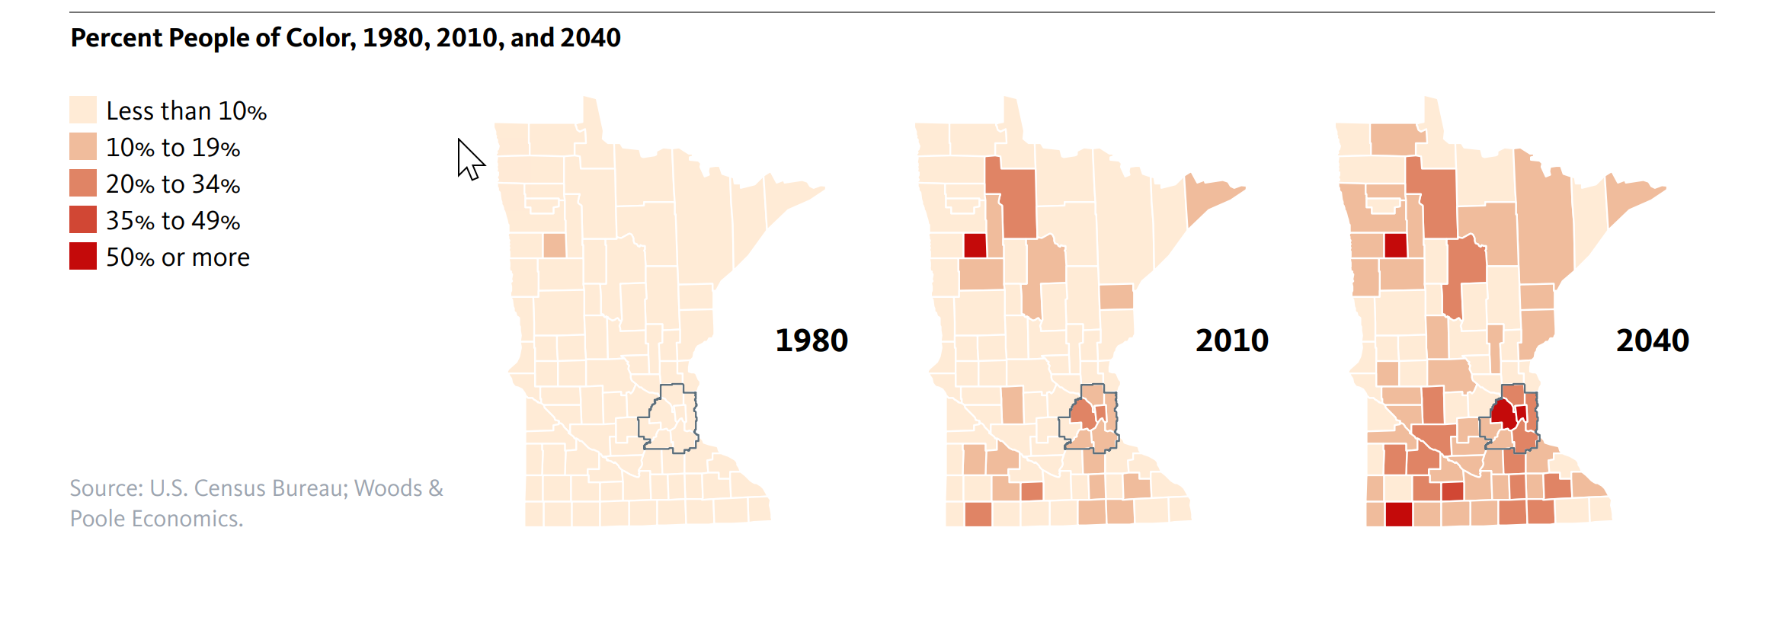
Hennepin’s growing diversity
Notes:
Top of mind for us at Hennepin and I’m sure many of you is the growing diversity of our region. By 2040 we anticipate Hennepin County will be more than 50% people of color.

Slide 4
Adult behavioral health population served
Served by adult behavioral health :
Hennepin County population
Notes:
And, as I’m sure you all know the population, we serve in ABH which includes some of your data, is more diverse than the general population. It’s important to keep that in mind when considering how we adjust to better serve the current population we support we also think about planning for the future. As Hennepin County diversifies, the population we serve will likely continue to be more diverse than the general population.
Unless, of course, disparities are reduced or eliminated.

Slide 5
2021 efforts
Community engagment focused on employment, IRTS, and culturally specific supports
Analysis of current contracts
TCM rate setting
Redistributing transportation and client flex funds
Notes:
A recap of what we have worked on so far this year.
5% of our current contracts are with culturally specific agencies or programs.

Slide 6
Culturally specific services
“services provided to specific populations based on their particular needs, where the majority of members/clients are reflective of that community and use language structures and settings familiar to the culture of the target population to create an environment of belonging and safety in which services are delivered”. Culturally specific organizations are deeply embedded in the communities that they serve, with “a culturally focused organizational identity and environment” and are recognized by the community as a strong partner in the work.
Notes:
At Hennepin we are really focused on culturally specific services. This definition gives you an idea of how we’re looking at it.
This is a definition taken from work done by Multnomah County, OR and matches what is in MN statute.
We acknowledge lots of great work is being done by all of our agencies to be culturally responsive, Hennepin included. We hope that all agencies continue to work toward being culturally responsive as the baseline for how we continue to deliver the highest quality of services for Hennepin County residents.

Slide 7
What we are hearing
INSERT 1-2 slides from the contract redesign project
Notes:
A recap of what we have worked on so far this year.
5% of our current contracts are with culturally specific agencies or programs.

Slide 8
Between now and 2022
Continued community engagement
Investigate savings from new MA billable services
Investigate transportation and client flex fund needs
Increase the % of contracts with culturally specific agencies

Slide 9
Next Adult Mental Health Initiative grant application 2023-2024
Maintaining the current vibrant system of support
Shifting outcomes to better meet community need
Increasing funding to culturally specific programming
Notes:
And are pushing us to avoid the trap of government to avoid change by avoiding risk, analyzing things ad nauseum, insisting we need more information or more data, etc.
Ask the group – who can think of a project or idea that they invested a lot of time and energy into that did not get implemented?
Human centered design model can be helpful in giving a structure to do CQI project well and to do them in a timely manner.
We are really good at analyzing the problem. We would encourage this group to spend more time focusing on what could be.

Slide 10
Public Value
Reduce disparities
Equitably distribute tax dollars back to all communities
Lift community voice and choice
Create a model for other county efforts

