Slide 1
Writing a case note based on the Professional Statement of Need
HHS Housing Stability – Housing Support
Version Date March 2022

Slide 2
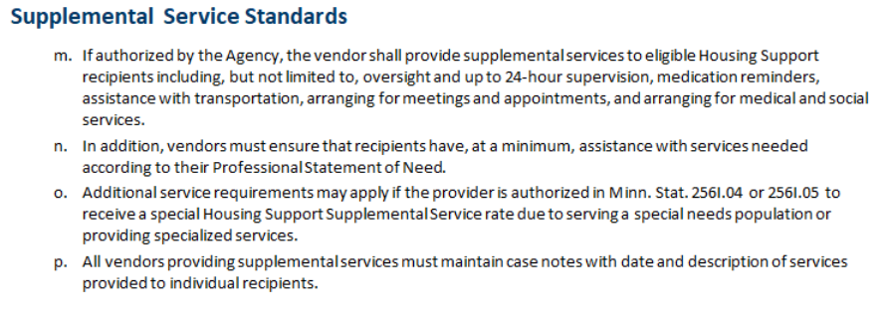
Housing Support Agreement
Case note requirement (p.)

Slide 3
Case Notes Overview – Part 1
Document services that address the client’s needs as indicated in the Professional Statement of Need. This ensures focused and concise case notes.
  Reminder: a qualified professional documents the client’s needs in Section 4: Minnesota Housing Support Supplemental Services of the Professional Statement of Need
Capture in your case notes all best practices that you used, including harm reduction, motivational interviewing, and person-centered practices. This demonstrates quality service delivery.
Note increased, decreased or no change in risk level for suicide, homicide and overdose. This sets up your critical next steps that ensure your client’s safety and well-being.
  Reminder: case notes are not where your responsibilities end. Follow your organization’s policies and procedures, such as consulting with your supervisor, when you observe your client at risk.
Case notes are proof that you delivered relevant services

Slide 4
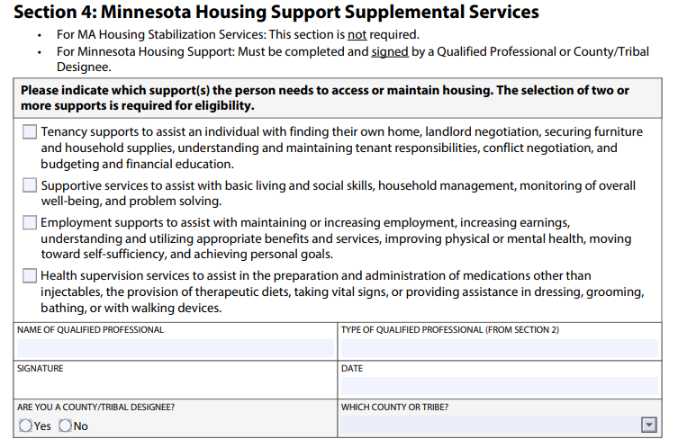
Professional Statement of Need (PSN)
Section 4: Minnesota Housing Support Supplemental Services contains information about the client’s needs as indicated by a Qualified Professional

Slide 5
Case Notes Overview – Part 2
Payment for the services you delivered can be approved or denied based on the quality and existence (or absence) of case notes.
Your performance and the performance of your program or organization can be evaluated based on your case notes during annual reviews and routine monitoring visits, compliance audits and complaint investigations.
  Note: Hennepin county may review your case notes at any time.
Case notes are proof of your work

Slide 6
Writing a case note - Part 1
Name of the client
Name of the worker
Date of the encounter when services were delivered
Start time of the encounter
End time of the encounter
Type or location of encounter: in-person, telephone, Zoom, email, text
Date when the case note was written
Record information about the encounter when a worker delivered services to a client

Slide 7
Writing a case note – Part 2
What need(s) indicated in the PSN is being addressed during the encounter?
What actions did the worker take?
What were the results of the worker’s actions?
What are the worker’s next steps?
Describe the services that the worker delivered during the encounter

Slide 8
Writing a case note – Part 3
What actions taken by the client did the worker observe during the encounter?
What were the results of the client’s actions?
What are the client’s next steps?
What did the client and worker observe that is impacting the client’s progress toward addressing the client’s need(s)?
Record observations about the client’s actions and progress

Slide 9
Writing a case note – Tips
Complete case notes as soon as possible after the encounter (no more than five days). If the case note is delayed, provide a brief explanation for the delay.
Start sentences with verbs to document actions taken. Describe only the actions that pertain to a client’s need(s).
List the names and actions of others who were present during the encounter.

Slide 10
Writing a case note – Verbs
Advised
Advocated
Arranged
Assisted with
Attended
Convened
Coordinated
Corresponded with
Explored
Facilitated
Informed
Monitored
Negotiated
Participated
Prepared
Problem-solved
Referred
Scheduled
Start sentences with verbs to document actions taken

