Slide 2
Housing Support Information Session for Prospective Providers
How to set your image in the placeholder
Right click image and select “format picture”
Select “Picture” tab
Select Crop from the drop down menu
Under Picture Position, use the Offset X and Offset Y to position your image within the frame
delete this when no longer needed

Slide 3
Welcome
Notes:
Welcome everyone! We’re happy you could join us today to learn more about becoming a Housing Support provider with Hennepin County.
We have two sessions scheduled – the first is from 11:00 – 12:00, where we will give a very high-level overview of the Housing Support program, the various sub-programs and the process of becoming a provider.
We will then host breakout sessions from 12:00 – 1:00 pm which will go more in depth about the various programs.
If you have questions during the presentation, feel free to use the ‘raise hand’ feature or write it in the chat. I can’t see the chat, so I ask my colleagues on the call to let me know if there are questions.

Slide 4
Plan For Today
Housing Support Program Overview
How to become a Housing Support provider with Hennepin County
Who the Housing Support Team Is and What Do We Do?
Breakout Sessions

Slide 5
Housing Support Program Overview

Slide 6
What is the Housing Support Program?
State of Minnesota helps people pay their rent
Pays up to $1135/month for room and board costs for people in group settings as of July 1, 2023
Pays up to $1185/month for room and board costs for people in community-based settings as of July 1, 2023
May pay for some supportive services that help people live in the community
Notes:
Housing Support is a state funded income supplement for housing costs, and in some instances, supportive services for people with disabilities and who have low income and assets. Housing Support payments are never paid directly to individuals but to an approved provider.
Some programs come with a supplemental service rate for services

Slide 7
3 Must Have’s
Eligible People
Eligible Places
Eligible Providers
Notes:
There are 3 Must Have’s to qualify for Housing Support. All three must be in place before housing support payments can be made from the state to the provider to cover the housing costs of a housing support recipient. We go over highlights here. You should have received some training material when enrolling for these sessions and the DHS Videos review these three must have’s in great depth.

Slide 8
Eligible People
Age 65+ or 18+ with a certified disability or disabling condition that prevents work to the level of self-support
Have low income and assets as defined by DHS
Have applied for and are approved for Housing Support program
Notes:
DHS GRH Basis of Eligibility website

Slide 9
Eligible Places
Community-Based Settings
Includes the Housing with Services-Independent (HWS-I), Long-term Homeless (LTH), and Demonstration Project (Demo) programs
Can be site-based or scattered-site
Participants must have a lease in their name with the option to prepare meals
Group Settings:
Board & Lodge
Assisted living licensed facilities for Customized Living Services recipients
Adult Foster Care and Community Residential Services
Notes:
These are qualified settings of the Housing Support program. Each setting has its own set of licenses and requirements. Having the required license and meeting the requirements ensures that the housing meets the needs of the people living there.

Slide 10
Eligible Providers
Sign a Housing Support Agreement with a county or tribal government, and
Offer food*, a bed and bedding, clothing storage, linen, laundry supplies, and housekeeping and must keep up the building and grounds.
*In community-based settings providers are not required to offer meals. They are required to ensure that living units have a basic kitchen where participants can fix their own nutritious meals. Participants can access SNAP benefits to help cover the cost of their food.

Slide 11
How to Become a Housing Support Provider in Hennepin County – Request for Proposal Process

Slide 12
What is the Request for Proposal (RFP)?
A document that:
Announces proposals are being accepted by Hennepin County from potential housing providers
Describes who is eligible to apply and requirements like deadlines, terms, and conditions
Notes:
Customized Living/Housing Support RFA – monthly and separate from the RFP

Slide 13



Behind the Scenes
Strategic planning to identify priority populations and critical needs
RFP is written to attract providers who can offer stable housing to priority populations and meet critical needs
Notification sent from Supplier Portal to providers about the RFP
Notes:
Briefly, where do RFPs come from? A request for proposal is developed through a series of steps.

Slide 14
Typical Timeline for the Annual Housing Support Request for Proposal (RFP) Process
Mid-January
Mid-February
Early January
Late-January
February-April
Notification of RFP sent from Supplier Portal
Optional public technical assistance sessions held
Questions submitted in writing; Addendum 1 posted
Applications due in Supplier Portal
Review and scoring of proposals and recommendation of award
Notes:
Here is a typical timeline of an RFP.
Typically, we issue RFP’s in the first quarter of the calendar year. An RFP can be issued at another time of the year, and it would generally follow this timeline. Hennepin County is planning on opening an RFP this summer for Community-Based Housing Support programs.
As you see, there is about a month between RFP issued and applications being due, with another 3-4 months for review and recommendation.
REVIEW OF PROPOSALS AND RECOMMENDATION OF AWARD: An expert panel, including Hennepin County and community representatives, reviews proposals, gives scores and recommends eligible providers to administration for final decision
Customized Living Housing Support program – customized living providers use a different process; application is available in the Supplier Portal now

Slide 15
What You Can Do Now…
Decide who you want to house (eligible people) and which type of housing (eligible place) you want to operate
Decide whether you will provide supportive services beyond housing and meals and how services will be paid for
Develop a business plan including operations, budget, licenses and registrations
Find a mentor with an organization that is doing what you hope to do
Review best practices and county priority populations
Register with the Hennepin County Supplier Portal

Slide 16
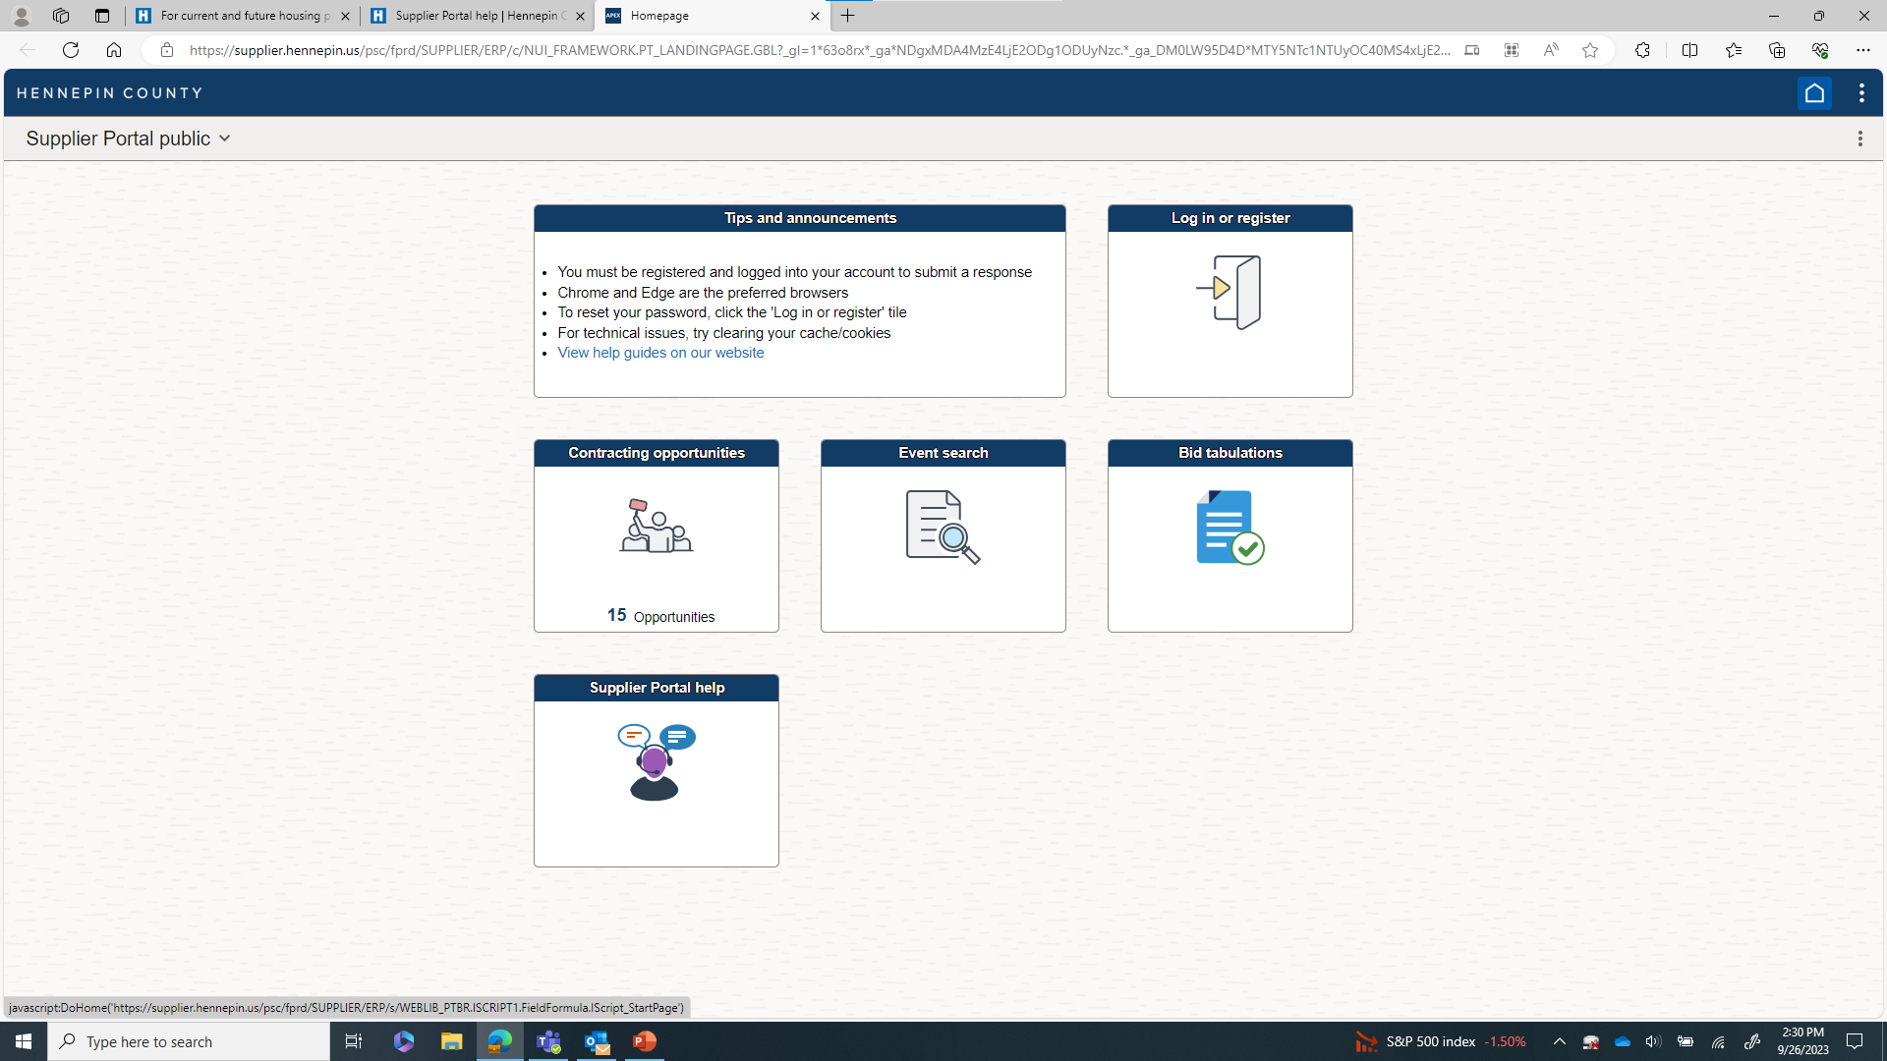
Supplier Portal – use ‘952’ for human services
Notes:
This is an image that may help you when you first navigate to the Supplier Portal.
You must register with the Supplier Portal to get notices about funding opportunities and submit proposals.
Be sure to register your “company code” as 952 (human services) when prompted.
Note to the host: For people who have joined by phone, they have Kristi’s one-page flyer “Becoming a Housing Support Provider” which has similar information about the Supplier Portal
https://supplier.hennepin.us/psp/fprd/SUPPLIER/ERP/h/?tab=HC_SUPPLIER_PUBLIC

Slide 17
What the Timeline Could Look Like for You
Mid-January to Early February
Early January
Mid-January
Early February
Mid-February
Download RFP from Supplier Portal and review in detail
Attend technical assistance sessions; Review Addendum 1
Draft your proposal; Revisit your model and budget
Finalize your proposal; Do you offer what the RFP is soliciting?
Submit application via Supplier Portal!
Notes:
Example based on typical timeline
After you submit your application, it is reviewed and scored by the panel. This can take up to three months.

Slide 18
Good To Know
Hennepin County selects a small number of Housing Support providers through the Request for Proposal (RFP) process
Housing Support program may not be best funding option for every provider and individual looking for housing
Visit HB101 - HB101 Minnesota - Programs & Services

Slide 19
Who is the Housing Support team and what do we do?

Slide 20
Quality Assurance
The Housing Support Team is responsible for quality assurance:
Help set up Housing Support Agreement, including annual renewal
Conduct routine monitoring of housing providers
Respond to complaints about housing providers
Provide technical assistance to housing providers about the Housing Support Program

Slide 21
Breakout Sessions
Notes:
Breakout session – technical assistance specific to housing and led by a lead
Have each lead introduce themselves and their housing

Slide 22
Get Technical Assistance with Your Questions at a Breakout Session
Board & Lodge
Community-Based Settings
*Includes the Housing with Services-Independent (HWS-I), Long-term Homeless (LTH), and Demonstration Project (Demo) programs
Assisted living licensed facilities for Customized Living Services recipients
Notes:
Each lead will talk about their housing – who is served, what kinds of services are delivered, what kind of housing where people live and where they may receive services
Community Residential Services (formerly known as adult foster care): the state of Minnesota and counties aren’t developing new CRS sites and so we aren’t looking for new CRS providers at this time. Let us know if you want more information, and we can get that to you.

Slide 23
Questions?
Notes:
End this call. Join the breakout session at Noon.

Slide 24
Housing Support Contact Info
HS.Housing.GRH@hennepin.us 612-543-2208
Notes:
Closing - Contact info, thank you

